Slide 1

Hazardous Area Considerations

Slide 2
NFPA70/NEC
National Fire Protection Association (NFPA) 70, National Electrical Code (NEC) is the benchmark standard for safe electrical design, installation, and inspection in the United States. Intended to protect people and property from hazards.
Hazardous Area Location (Hazloc)
A space where a risk of fire or explosion exists due to the presence of flammable gases, vapors, liquids, combustible dusts, or ignitable fibers/flyings.
Hazardous Area Classifications
Two systems can be used to classify hazardous areas; the Class/Division system and the Zone system. The Class/Division system is used predominantly in the United States and Canada while the rest of the world generally uses the Zone system.
Lower Explosive Limit (LEL)
The minimum concentration of gas in air expressed as a percentage by volume that can support combustion in the presence of an ignition source.
Ignition Temperature
The lowest temperature that gas will ignite spontaneously without a spark or flame.
Intrinsically Safe (IS) equipment
Devices and wiring incapable of releasing sufficient electrical or thermal energy, under normal conditions, to cause an ignition of gas at its most easily ignited concentration.
Explosion Proof
Equipment designed to contain an internal explosion of flammable gas within its housing.

Slide 3
NFPA 70 (NEC) Classes, Divisions and Groups
Classes defines the material type
Class 1: Flammable gases/vapors
Class 2: Combustible dusts
Class 3: Ignitable fibers or flyings
Divisions indicate the probability of an ignitable concentration
Division 1 (Normal Hazard): Areas where flammable gasses or vapors are likely to exist under normal operating conditions, or frequently because of maintenance/leakage.
Division 2 (Abnormal Hazard): Areas where flammable gases or vapors are not likely to exist under normal conditions but might appear due to accidental rupture, breakdown, or faulty operation.
Groups define explosive gases or dusts. Used alongside Classes and Divisions. Groups B and D will be discussed in this presentation.
Group B: Hydrogen, butadiene, ethylene oxide, propylene oxide, acrolein.
Group D: Acetone, ammonia, benzene, butane, ethanol, gasoline, methane, propane, toluene. (Odorant would generally fall in this group).

Slide 4
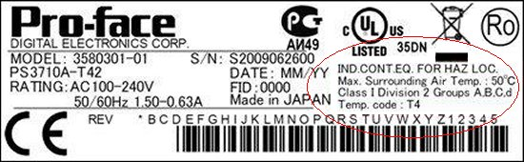

Slide 5
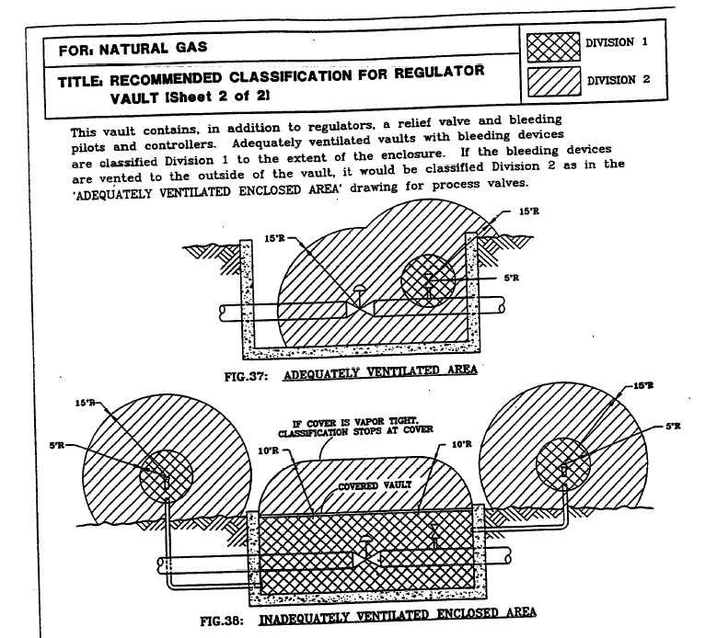

Slide 6
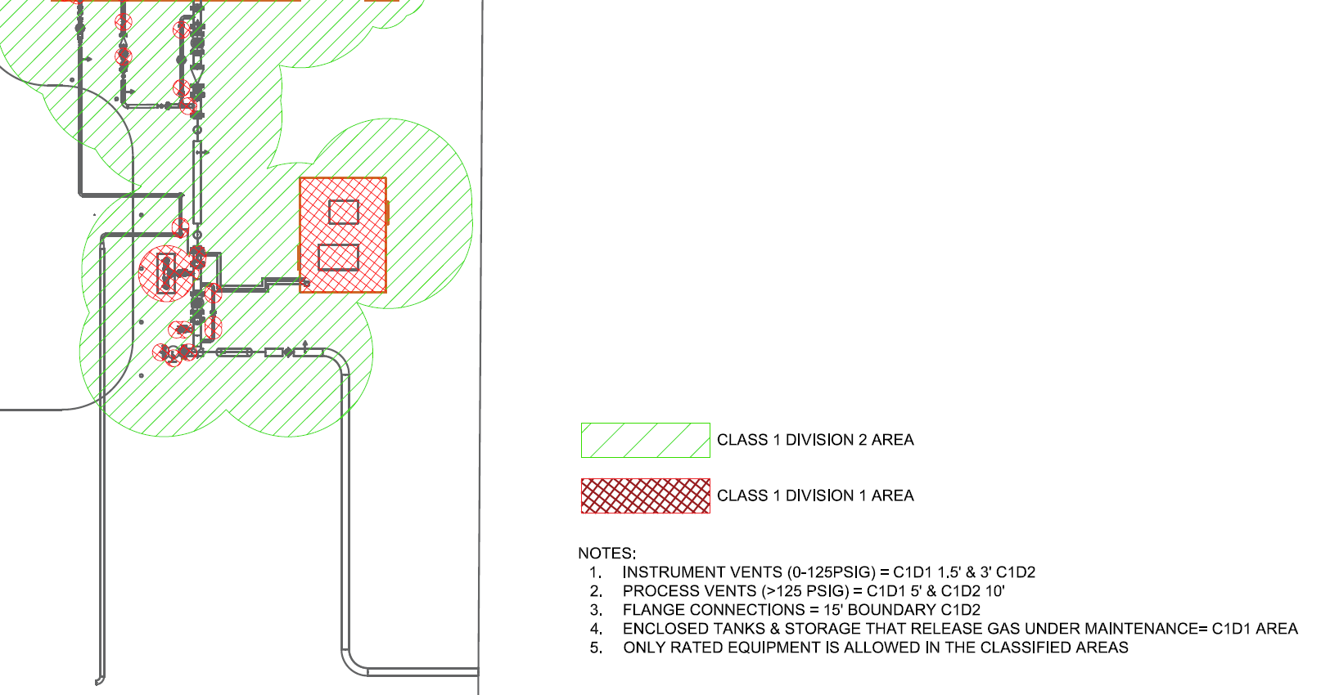

Slide 7

Intrinsically Safe

Slide 8
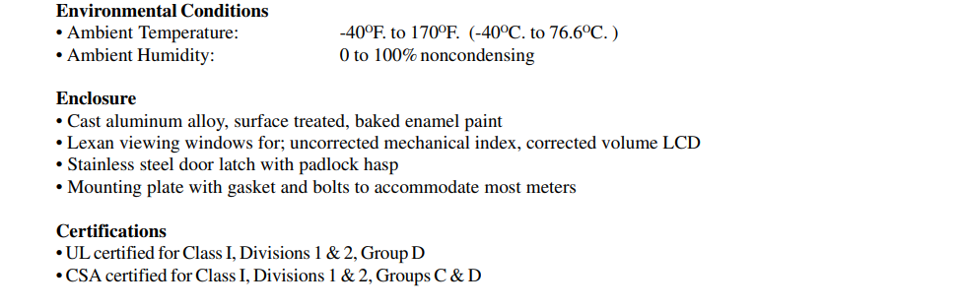

Slide 9
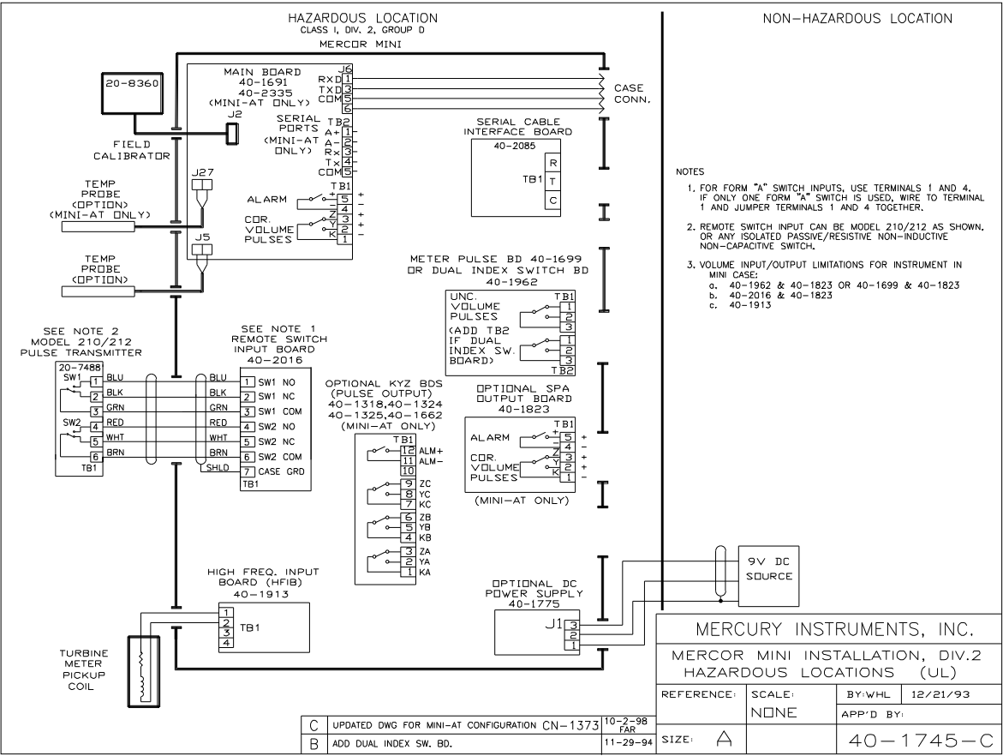

Slide 10
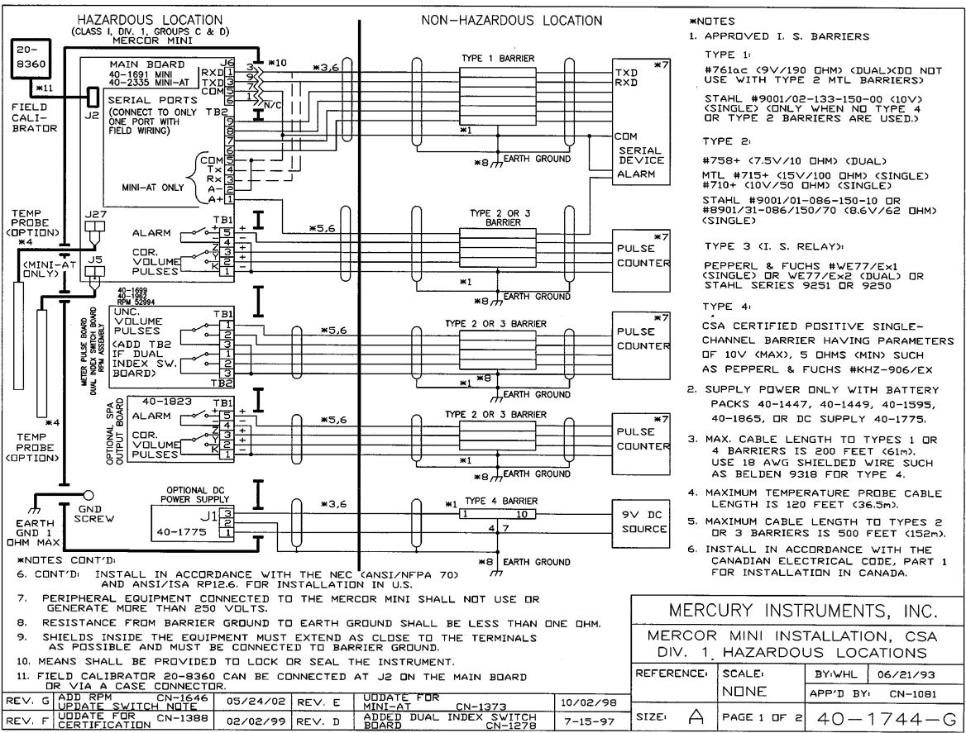

Slide 11
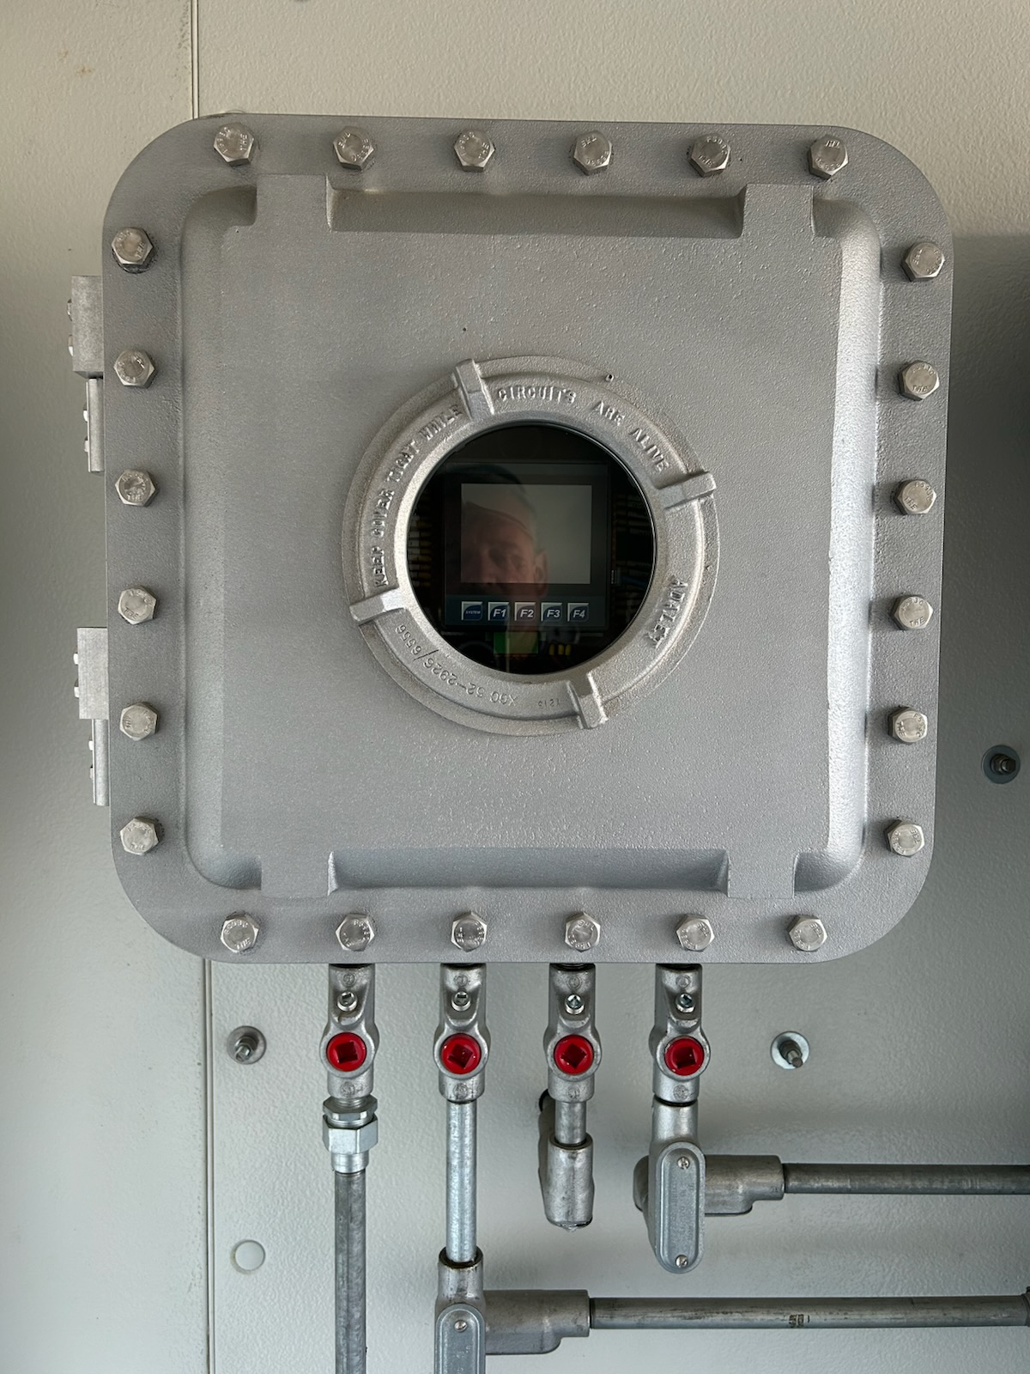
Explosion Proof

