Slide 1

If the Number is Wrong… everything is wrong
Electronic Flow Computing Role in Gas Measurement
Presented by: Jimmy Weaver – Tri-Pacific, Inc.
Notes:
If the number is wrong… Everything is Wrong.
In natural gas measurement… we’re not measuring gas. We’re measuring money.

Slide 2
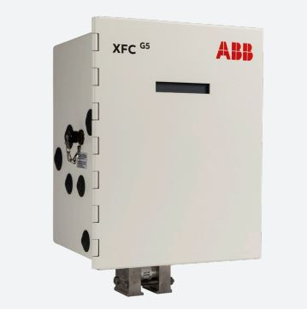
Introduction to Electronic Flow Computers (EFC)
Basic Flow Computer (EFC) or Electronic Gas Measurement (EGM) is an integrated system designed to accurately record, quantify, and calculate the volume of gas or hydrocarbons.
Notes:
To fully appreciate the role of a flow computer, lets start by defining it.
A basic flow computer is not just any device; it's an integrated system engineered to record, quantify, and calculate the volume of gas or hydrocarbons with high accuracy.
But modern flow computers, like the ABB model shown, go beyond mere measurement.
They are the brains behind the automation of complex processes such as valve control, gas lift operations, and safety shutdown systems, among others.
These capabilities are just the tip of the iceberg in what these sophisticated instruments can achieve."

Slide 3
SETTING THE STANDARD
American Petroleum Institute (API)
  21.1 Flow Measurement Using Electronic Metering Systems
American Gas Association (AGA)
American National Standards Institute (ANSI)
International Organization for Standardization (ISO)
National Institute of Standards and Technology (NIST)
Notes:
As the demand for electronic measurement systems grew, the necessity for a unified standard across manufacturers became evident.
The agencies listed
all have standards that deal with the Gas industry however for todays topic our primary focus is American Petroleum Institute or (API) and its Chapter 21.1
Titled “Flow Measurement Using Electronic Metering Systems – Electronic Gas Measurement.

Slide 4
Importance of Accurate measurement
Economic implications of measurement accuracy: Custody transfer, Royalties, and Customer Payments.
Precise measurements are crucial for fair and auditable transactions between gas producers, utility companies, and end consumers.
Notes:
Before we explain the components of a flow computer, its important that we understand why we would need a flow computer.
Several issues highlight the need for such systems.
A prime issue is that, without a volume agreement from both the buyer and the seller, it would be impossible to accurately value gas.
The buyer is thus obliged to rely on the seller's data for the accurate pricing of gas quantities.

Slide 5
Challenges in gas measurement
A challenge in gas measurement is the diversity of conditions under which gas can flow.
Transform measurement data into like units for calculations.
Converting Actual Cubic Feet (ACF)/hr to Standard Cubic Feet (SCF)/hr to account for pressures, temperatures, and compressibility of the gas.
Notes:
The solution to accurate valuation in a natural gas transaction involves both the seller and buyer using their own meters.
However, simply having two meters does not address the issue known as the diversity of conditions under which gas is measured.
For instance, gas measured in Actual Cubic Feet (ACF) at different elevations, such as 3000 feet versus sea level, will yield different volume readings due to variations in pressure and temperature.
Consequently, it's crucial to convert these measurements from Actual Cubic Feet (ACF) to a standardized unit like Standard Cubic Feet (SCF) or British Thermal Units (BTUs)

Slide 6
Valuation of Natural Gas
Natural gas is sold by the Therm (th) or British Thermal Unit (BTU).
1 therm = 100,000 BTU.
The formula to calculate 1 Therm is SCF/hr * BTU/hr / 100,000 BTU.
1,000 SCF/Hr x 1020 BTU/SCF = 1,020,000 BTU/Hr or 10.2 Therms per Hour.
Notes:
Natural gas, typically sold in units of therms, with one therm being equivalent to 100,000 British Thermal Units (BTU). The term 'therm' is also used to describe 100 cubic feet of gas by volume, while a BTU represents the heat required to raise the temperature of one pound of water by one degree Fahrenheit.
To calculate the energy content of natural gas flow in therms, we use the following formula:
1 therm equals 100,000 BTU.
The number of therms per hour is calculated by multiplying the gas flow in Standard Cubic Feet per Hour (SCF/Hr) by the energy content in BTU per Standard Cubic Foot (BTU/SCF) and then dividing by 100,000 BTU.
Take this example: If the gas flow is 1,000 SCF per hour and the energy content is 1,020 BTU per SCF, the calculation proceeds as follows:
Multiply 1,000 SCF/Hr by 1,020 BTU/SCF to get 1,020,000 BTU per hour. Then, divide 1,020,000 BTU by 100,000 BTU per therm to get 10.2 therms per hour.
So, in this scenario, the gas flow would be delivering an energy content of 10.2 therms every hour.

Slide 7
Basic components of an EGM/efc system
Enclosure – protective casing that houses components.
CPU/Processor - calculations based external inputs.
Software/Firmware – a set of rules define how data is processed.
Main Electronics Board – connection to external devices.
Connection options, Local, Remote – enables data transmission.
  Human Machine Interface (HMI) Man Machine Interface (MMI)
Primary and Secondary flow devices – Sensor data required for measurement.
Notes:
The essential components of an Electronic Gas Measurement (EGM) or Electronic Flow Computer (EFC) include the enclosure, which protects the central processing unit (CPU) — the heart of the system.
Accompanying this is the software and firmware, programmed to process sensor data, culminating in a precise measurement record or Quantity Transaction Records (QTRs)
The main electronics board acts as the conduit for this process.
Connection options also referred to as the Human Machine Interface (HMI) or Man Machine Interface (MMI) provides data for human interaction.
Completing the setup, primary and secondary flow devices supply the critical sensor data necessary for measurement.

Slide 8
Enclosure
Acts as a shield protecting sensitive electronics from external damage.
Notes:
The enclosure protects sensitive electronic components from dust, rain, water and extreme temperatures. The enclosure will have weatherproof openings to connect primary and secondary devices.

Slide 9
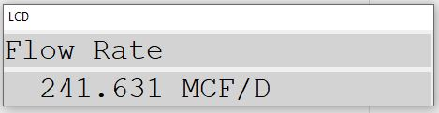
LCD display optional keypad
Liquid crystal display (LCD) allows on-site visual monitoring of conditions.
Optional Keypad enables user to interact without a PC.
Notes:
The LCD or Liquid Crystal Display enables the user to visually monitor the systems status, data and alarms.
Systems equipped with customizable displays and optional keypads enable users to make minor adjustments to the flow computer directly, eliminating the need for a PC.

Slide 10
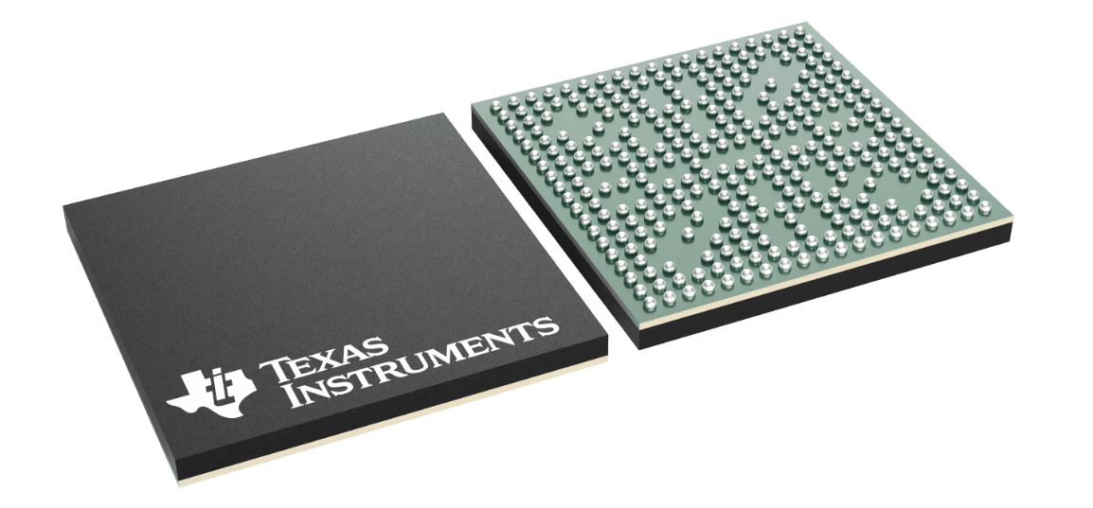
CPU or Processor
Central Processing Unit (CPU) – brains of the system.
Notes:
The CPU can be referred to as the brains of the system, this component processes all incoming signal data. It processes all the instruction sets contained in the firmware and handles all the data exchange between systems.

Slide 11
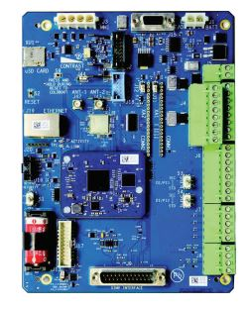
Motherboard
Main electronics board – electrical interface to primary and secondary devices.
Notes:
The motherboard acts as the foundational component of the system, integrating the main electronics board, the processor and the interfaces for both primary and secondary devices.

Slide 12
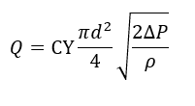
Software / firmware
The software is the foundational system for running instructions.
Firmware is a specific set of instructions that turn sensor data into flow data.
Notes:
Core software provides the foundation system necessary for running the software libraries and code base that the firmware relies on.
The firmware is a specific set of instructions that turn calculation represented in the slide from the AGA Report No 3 into machine readable code for the basic measurement of an orifice meter.

Slide 13
Communications
Local Communications – Serial (RS-232, 485, 422) Universal Serial Bus (USB), Ethernet (TCP), Bluetooth.
Protocols: Modbus, HART, Profibus, Fieldbus, and recently MQTT
Remote Communications – Radio, Ethernet (TCP), Cellular, Satellite.
Notes:
Modern flow computer have several options when it comes to retrieving the data.
Common communication types are RS-232, 422, 485, Universal Serial Bus (USB) “Local”, Ethernet (TCP), Bluetooth
Flow computers may employ various protocols such as Modbus, HART, Profibus, Fieldbus, and, more recently, MQTT.
Although remote communication employs many of the same methods as local connections, the transmission of data back to servers or SCADA systems typically utilizes radio, cellular, CDMA modems, or satellite links.

Slide 14
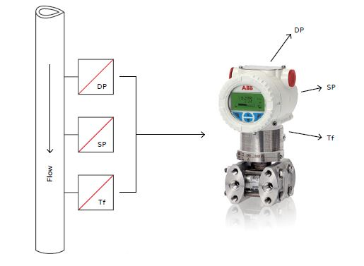
Transducers and transmitters
Secondary devices: Electromechanical transducers respond to various inputs, pressure, temperature, frequency, relative density.
Notes:
In electronic measurement systems, the secondary devices are often electromechanical in nature.
They respond to various inputs from the pipeline such as pressures, temperatures, frequency, relative density.
They do this by changing their electrical output in response to these inputs. When we fit these devices with special circuits, they become transmitters. These added circuits transform the transducers outputs into a standard signal, which might be analog, digital, or frequency based.
The ABB 266 transmitter pictured above uses Modbus tables to transmit it’s data to the flow computer.

Slide 15
Measurement techniques Differential
Upstream Pressure Tap (P1 – High Side)
Downstream Pressure Tap (P2 – Low Side)
ΔP = P1 – P2
Orifice Plate (Restriction)
Vena Contracta (Point of Lowest Pressure)
Flow ∝ √ΔP
Notes:
Reality Check:
2× ΔP ≠ 2× Flow
Errors in ΔP → amplified in flow
Notes:
“We’re not measuring flow directly—we’re measuring pressure loss.”
“That loss happens because we force the gas through a restriction.”
“Here’s the key: flow is proportional to the square root of ΔP.”
“So if ΔP goes up by 4… flow only doubles.”
(Pause here—this is where most people get it wrong)
“If your DP doubles and your flow doubles, something is broken.”
PRO TIP
“Most bad measurements come from the basics:
Wrong orifice plate size
Plugged impulse lines
Wet gas / liquids on the plate
Bad DP calibration”

Slide 16
measurement techniques
4 – 20 Current loop
Current signal from 4-20 mA represents process value
Signal is immune to voltage drop over distance
Uses twisted pair shielded cable
Shield protects against electrical noise (EMI/RFI)
Shield should be grounded at one location only
  Prevents ground loop currents
  Maintains stable signal to flow computer
Notes:
Core Points
4–20 mA = current represents measurement
Current > voltage for distance + noise immunity
4 mA = live zero (fault detection)
Loop needs power source
Shield = noise protection
Ground ONE SIDE ONLY (flow computer side)
One Key Teaching Moment
👉 “If you ground both ends → you create a loop → loop creates noise”
Keywords to Hit (don’t miss these)
“live zero”
“immune to voltage drop”
“ground loop”
“signal integrity”

Slide 17
measurement techniques
Analog to digital converter
Converts variable analog signals into digital signals, representing values at discrete levels.
Calibrating involves setting the zero reference (offset) and accurate scaling (gain) to ensure precise measurements from 0 volts across input range.
Enables precise measurement of analog signals to facilitate digital processing.
Sampling rate and resolution. May not capture rapid signal changes.
Notes:
Principle: Converts analog signals, which vary continuously, into digital signals, representing values at discrete intervals.
Calibration: involves adjusting device settings for zero reference (offset) and accurate scaling (gain) to ensure precise measurements from 0 volts across its input range.
Strengths: Enables precise, high-resolution measurement of analog signals, facilitating digital processing and analysis.
Weaknesses: Sampling rate and resolution limitations may not capture rapid signal changes, leading to potential data loss (aliasing).

Slide 18
measurement techniques
Pulse Measurement
Pulse measurement used to determine the volume of gas passing through a pipeline.
Each pulse equals fixed volume
High accuracy: Direct integration to EFC without need to A/D Converter
Notes:
Principle:
Pulse measurement is a technique used to determine the volume of gas passing through a system.
A flow meter generates electrical pulses, where each pulse represents a fixed volume of gas.
The total number of pulses over a time period is counted to calculate the total flow volume.
Calibrations:
Calibration involves setting the pulse output to match the known volume of gas.
Strengths:
High accuracy: Provides precise volumetric flow measurements.
Direct digital output: Facilitates easier integration with digital systems and EFCs without needing analog-to-digital conversion.

Slide 19
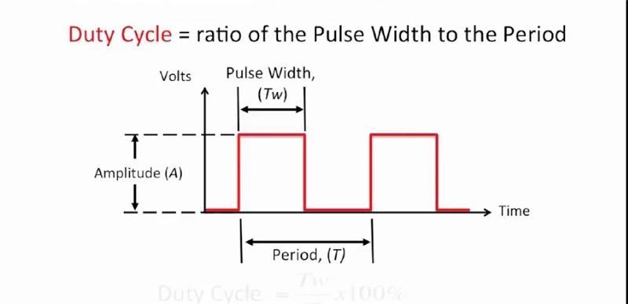
Measurement = counting edges, not voltage
Rising Edge (0 → 1) Falling Edge (1 → 0)
Notes:
The system doesn’t care about voltage level—it cares about the moment the signal crosses a threshold.
That moment is your edge—that’s what gets counted.
If you count both edges, you just doubled your flow… incorrectly.
Pulse width matters—too fast, and your flow computer won’t even see it.
Unlike analog… if you miss it, it’s gone. No averaging. No recovery.”
Principle:
Pulse measurement is a discrete (digital) method where each pulse represents a fixed quantity (volume, energy, or counts).
A pulse is defined by a transition across a voltage threshold (typically LOW → HIGH or HIGH → LOW).
Rising Edge: Transition from LOW to HIGH (0 → 1).
Falling Edge: Transition from HIGH to LOW (1 → 0).
Measurement systems count edges, not voltage levels.
Pulse Width: Duration the signal remains in one state (typically HIGH).
Duty Cycle: Ratio of ON time to total cycle time (%).
$$\text{Duty} \text{Cycle}=\frac{T_{ON}}{T_{TOTAL}}×100\%$$
Frequency (pulses per second) determines rate; total pulse count determines accumulated volume.
Edge Selection (Critical):
You configure systems to count either rising OR falling edges to avoid double counting.
Selection is based on:
Signal stability (cleaner edge = better choice)
Device specification (manufacturer-defined output behavior)
Noise characteristics (one edge is often less susceptible to bounce or ringing)

Slide 20
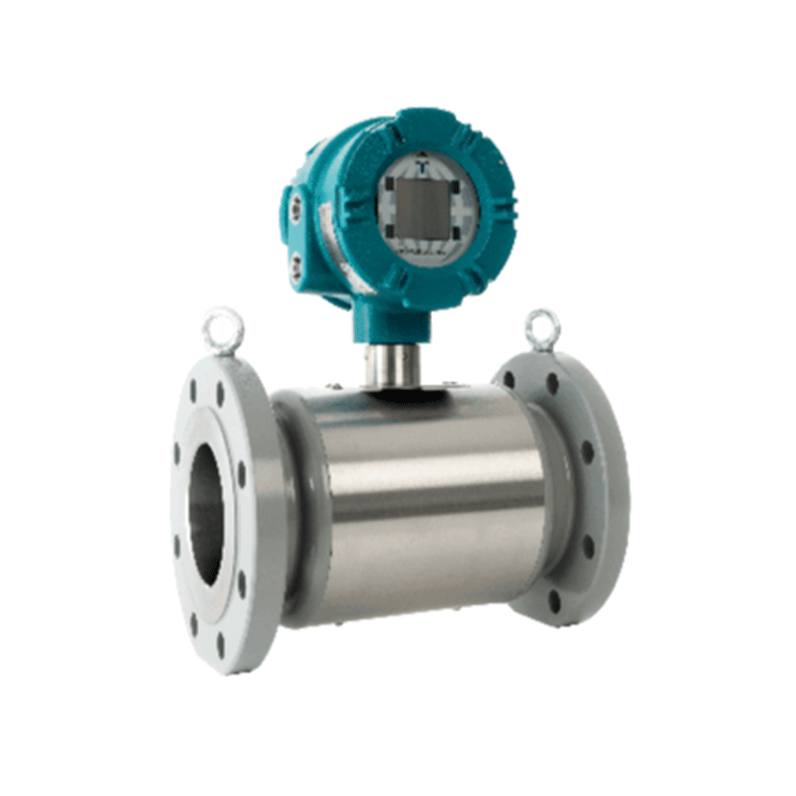
measurement techniques ultrasonic
Measures flow using sound waves
No moving parts
High accuracy
Measures velocity directly
Notes:
Principle:
Ultrasonic measurement uses sound waves to determine the flow of gas through a pipe.
Transducers send signals with and against the flow direction.
The difference in travel time between upstream and downstream signals is used to calculate gas velocity.
Calibrations:
Calibration involves verifying transducer spacing, timing accuracy, and flow profile assumptions.
Typically validated using reference meters or known flow conditions under laboratory conditions.
Strengths:
High accuracy: Provides precise volumetric flow measurements.
Direct digital output: Facilitates easier integration with digital systems and EFCs without needing analog-to-digital conversion.
Weakness:
• Sensitive to flow profile disturbances (elbows, fittings, poor installation)
• Requires proper installation and straight pipe runs

Slide 21
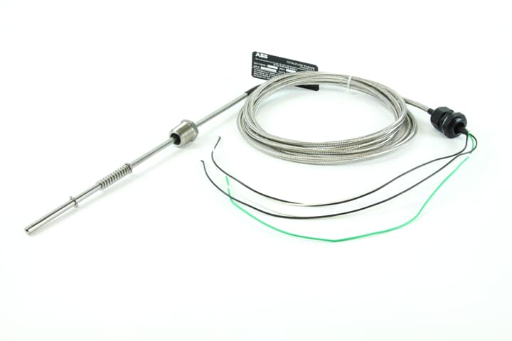
Temperature (TE)
Resistance Temperature Detector(RTD)
  Resistive element
Thermocouple(TC)
  Operated by voltage
Temperature probe inserted via thermal well.
Notes:
Two prevalent methods for determining temperature are Resistance Temperature Detectors (RTD) and Thermocouples (TC).
Resistance Temperature Detectors (RTD): Measure temperature by correlating the resistance of the RTD element with temperature.
Thermocouples (TC): Use the thermoelectric effect to measure temperature they rely on voltage in the mV range for this measurement.
Both RTDs and TCs can be extracted for calibration or maintenance without depressurizing the pipeline with the incorporation of a thermowell.
Calibration or testing is performed using a standard multimeter, and manufacturers provide a chart with expected resistance or voltage readings for various temperatures."

Slide 22
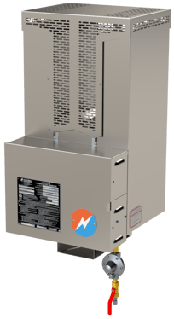
Power Options
Designed on energy-efficient operation principles.
  Low power adapted for areas with no utility service.
Uninterrupted operation solutions.
  Primary operation from battery.
Battery and charging options: Solar, Thermal Electric Generator.
  Primary: Solar where sufficient sunlight exists.
  Alternative: Thermal electric generators using pipeline gas as fuel source.
Notes:
In selecting a flow computer, it's crucial to consider the system's power requirements, especially since many units are deployed in remote locations lacking utility services.
Key features include the system's ability to operate continuously, which is made possible by battery power.
For charging options, solar panels are the primary choice in areas with ample sunlight, while an alternative is the use of a (Global Power 10W–550W) thermoelectric generator that harnesses power from the pipeline gas itself

Slide 23
Data Management
API 21.1 3.2.4 Mandates EGM systems comply with audit requirements.
  Reported volumes
  Mass/energy quantities
  Quantity transaction records (QTR)
  Corrected Quantity transaction records (QTYcorr)
  Configuration logs
  Event logs
  Field test or calibration reports provide accuracy evidence for primary and secondary devices.
Notes:
API 21.1 3.2.4 mandates that EGM systems must comply with audit trail/audit package requirements
reported volume, mass and/or energy quantities.
All editing of data in the EGM or other systems shall be identified.
Quantity Transaction Records (QTRs) that are modified or corrected by systems, either manual or automatic, must be recorded and maintained as part of the audit trail.
Configurations and system events, in addition field test reports that provide accuracy evidence for primary and secondary devices.
The QTR record for Differential and Linear meters are not identical however they both share some common primary fields.
Date and Time or Date Time identifier
quantity (volume, mass and or energy)
Flow time:
Integral value: Total volume of gas reported during a specific period

Slide 24
Conclusion
EFC's role in gas measurement cannot be overstated.
EFCs automate otherwise cumbersome tasks.
  Controlling systems based on actionable data.
  Accurately record and calculate gas movement within pipelines.
Industry advancements continue to scale and adapt EFCs to business requirements.
Notes:
In the world of gas measurement and custody transfer, the role of the Electronic Flow Computer (EFC) cannot be overstated.
This paper has only scratched the surface of these sophisticated devices.
Conclusion: Electronic Flow Computers (EFCs) bridge the gap in what would otherwise be a manual and arduous process of measuring, recording, and verifying accurate values.
As the industry evolves, the flexibility and expandability of EFCs will continue to be crucial.
This document stands as a testament to the innovation and collective wisdom of the professionals who have shaped our industry.
Thank you.

