Slide 1
Isolation Methods for Hot Work
Beau Gibbs, WBI Energy

Slide 2
Why Isolation for Hot Work Matters
Protecting People Comes First
  Hot work introduces ignition sources into environments where flammable gas may exist or be unintentionally released
  Positive isolation is the final barrier that prevents energy, pressure, or gas from reaching the work area
  Failures in isolation are rarely minor—they can lead to serious injury, fatality, or catastrophic facility damage
Why It Matters
  Safety decisions affect real people—not just equipment
  The goal is simple: Do the job safely, so everyone goes home to their family

Slide 3
Who’s Responsible
Engineering Responsibility
  Engineers must understand hot work risks and isolation methods
  Facility designs must intentionally include:
    Practical, effective isolation points
    Proper equipment selection and placement
    Good designs enable safe work; poor designs force unsafe decisions
Field Responsibility
  Field personnel must understand equipment capabilities and limitations
  Know when positive isolation is required—and when it is not negotiable
  Assumptions or shortcuts can place everyone onsite at risk
Shared Accountability
  Hot work safety depends on informed design and informed execution
  Knowledge gaps at any stage undermine even the best procedures

Slide 4
Prevention of Accidental Ignition
Hot work:
  Any task that can introduce an ignition source in an area where flammable gases may be present (hazardous area).
    Requires verification and maintenance of a safe area before and during work
    It is the responsibility of the person operating the equipment to ensure a safe atmosphere exists prior to and during its use
  Ignition sources:
    Obvious: Welding, torch cutting, grinding, etc.
    Less obvious: Low voltage electrical devices that aren’t intrinsically safe
      Cell phones, laptops, hearing aids, smartwatches, bore scopes, GPS units, power tools
    Avoid static electricity: wear FR clothing, electrically ground equipment (hoses, hurricanes) with high velocity gas/air flow through them
    Heat from a weld can exceed autoignition temperature of gas/air mixture
  Safety Reminders: Know and follow your company’s procedures!
    Declassify an area before (within 15’) before using electronic equipment
    Continuously monitor atmosphere with use of personal gas monitors
    Fill out JSA with the safe work checklist and hot work permit prior to starting work

Slide 5
Isolation Definition
OSHA 1906.1202: Isolate or isolation means the process by which employees in a confined space are completely protected against the release of energy and material into the space … by such means as:
  Blanking or blinding;
  misaligning or removing sections of lines, pipes, or ducts;
  a double block and bleed system;
  lockout or tagout of all sources of energy; blocking or disconnecting all mechanical linkages;
  or placement of barriers to eliminate the potential for employee contact with a physical hazard.
API 6D (Double Isolation and Bleed) - Specifically defined in reference to seat types in trunnion ball valves

Slide 6
Isolation Methods
Familiarize yourself with your company’s safety procedures
Four common methods:
  Positive Mechanical Isolation (OSHA)
    Remove pipe pup and install blind flange on valve
    Spectacle blinds
  Double block and bleed with two valves (OSHA)
  Single valve isolation with DPE (dual piston effect) seats and body bleed (API)
  Single valve isolation with Venturi air mover (WBI)
Design your new facility or piping modifications to provide positive isolation during installation or future modifications. Valve selection, valve placement, field fit locations, removable pups, taps/risers for Venturi air movers, etc. should be intentionally designed into the facility.

Slide 7
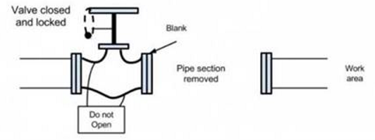
Positive Mechanical
Isolation –
Removable Spool
Safest method to ensure positive isolation
  No venting gas during hot work operations
  Can be left for long term isolation of facilities
  If intentionally designed into new facilities, removable spools/spectacle blinds can also be used to isolate stations from pipeline hydrotest operations.
Often, it’s the least convenient
  Most existing facilities have fewer flanged connections (fewer valves, use welded valves, or have less equipment in general)
  Method is often impossible or impractical for most existing facilities
  Removed spool USUALLY has an insulating gasket kit. Don’t forget to check
  Often requires special lifting equipment to remove spool

Slide 8
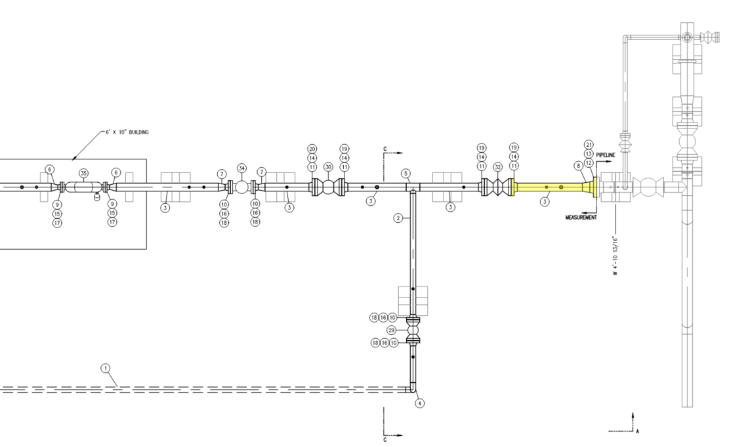
Removable spool provides construction schedule flexibility for pipeline vs measurement facilities and provides positive isolation for any hot work done to station piping.
Install the pup for alignment of facilities, then remove it for hot work or hydrotesting operations.

Slide 9
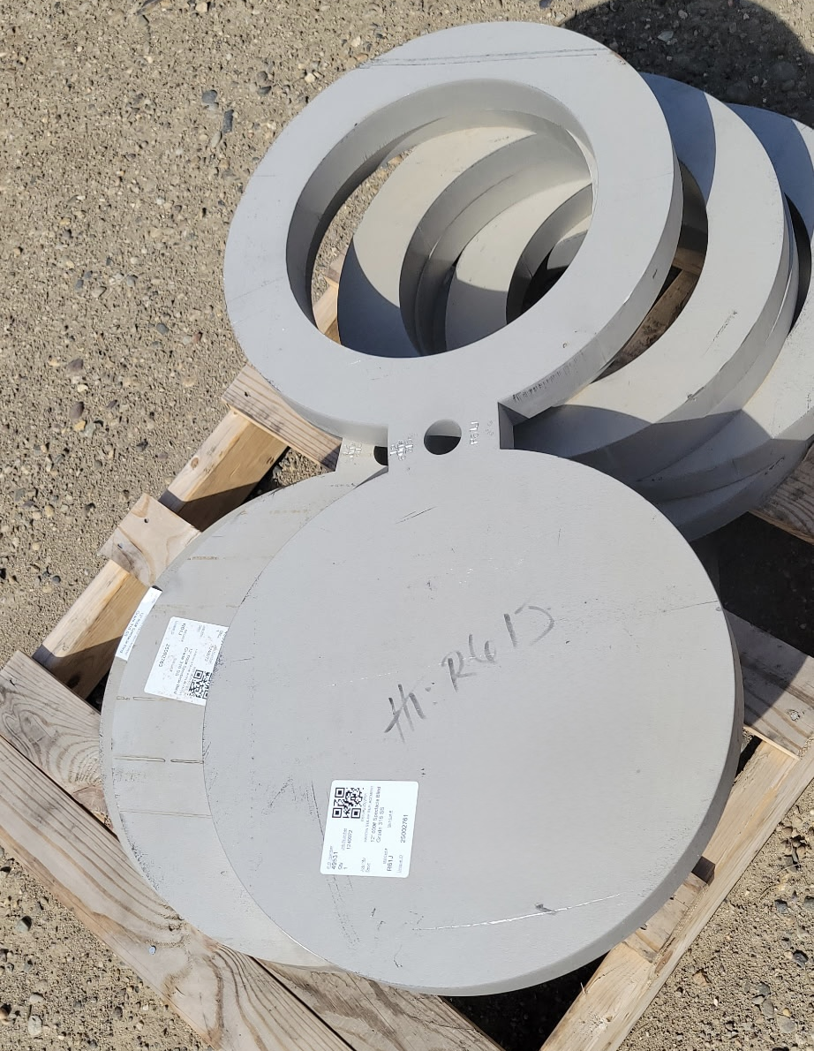
Positive Mechanical Isolation – Spectacle Blinds
A spectacle blind is a figure‑eight‑shaped metal plate installed between flanges that provides positive, visual isolation of a pipeline by rotating between an open spacer and a solid blind position.
Advantages: no venting gas, can be left for long term outages, convenient for pipeline hydrotesting, doesn’t need special lifting equipment (usually spins on stud bolt)
Disadvantages: permanent, adds another gasketed connection (potential leak source), not aesthetic, inconvenient for insulating gasket kits, makes flange alignment more difficult
Note: Don’t purchase smooth spec blinds! Request spiral serrations to improve the seal with the gasket.

Slide 10
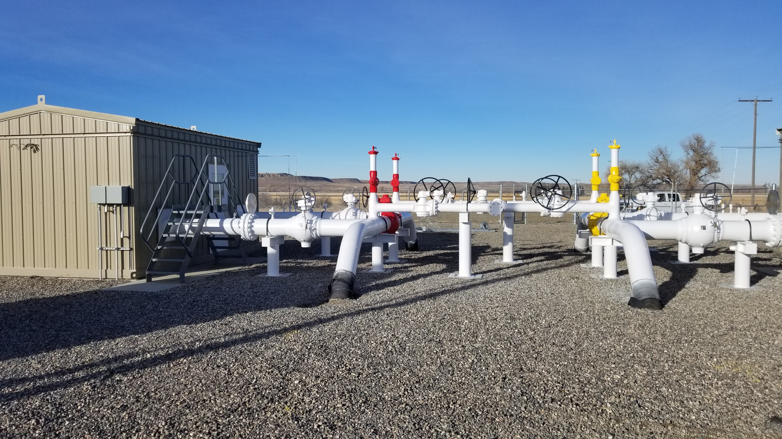
Positive Mechanical Isolation – Spectacle Blinds

Slide 11
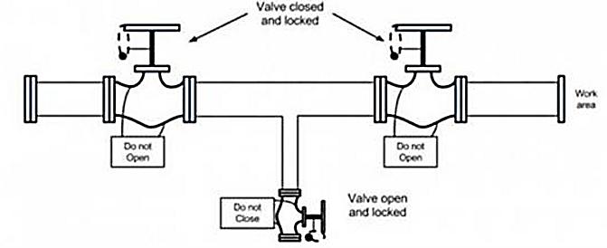

Double Block and Bleed (two block valves)
OSHA’s definition of double block and bleed (differs from API)
  May involve more valves. Basic concept - upstream valve(s) to isolate pressure source, downstream valve(s) to prevent any leaked gas from entering the work area, and a bleed valve in between
Doesn’t matter what valve types are used (plug, ball, etc.)
More convenient than mechanical isolation
Can be intentionally designed into station
Intuitive for valve operating procedures
Requires Lockout/Tagout
Will vent gas if upstream valve leaks; may need to hose away from work area or outside of building
Cost – usually adds an extra valve that may not serve another purpose
Takes up additional space

Slide 12
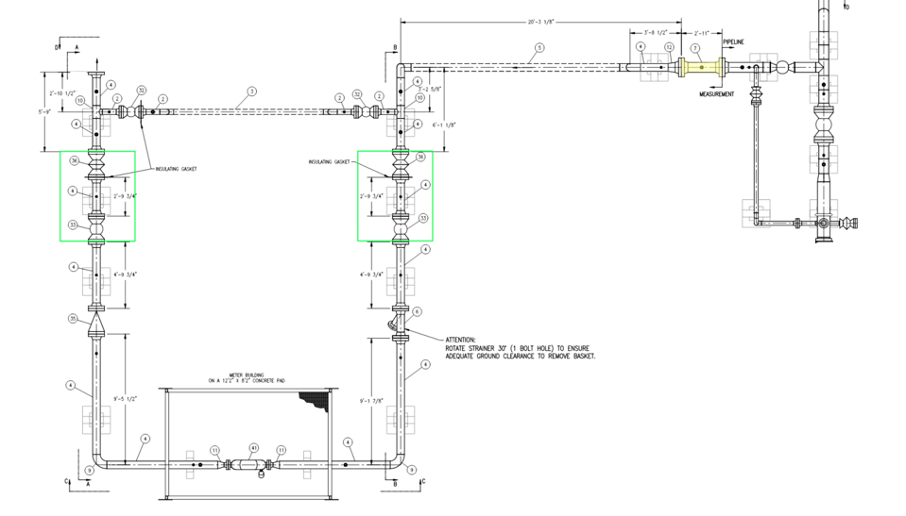
Removable spool provides construction schedule flexibility for pipeline vs measurement facilities and provides positive isolation for any hot work done to station piping.
Plug valve at the inlet allows the station to be purged and equalized after any hot work is performed in the station. Plug valve at the outlet allows purging/equalizing of customer's system.
Adding a ball valve as the second block valve provides positive isolation for most of the station piping. Save cost with ball valves vs plug valves.

Slide 13
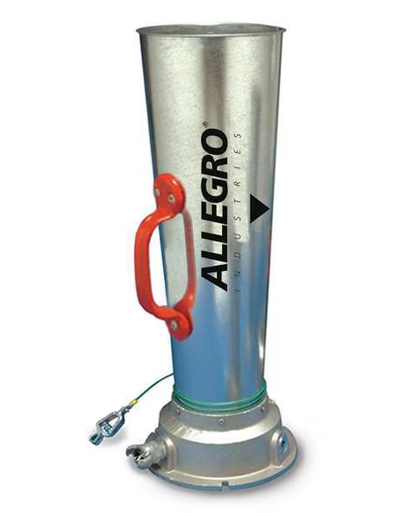
Positive Isolation – Single Valve with Venturi air mover
Utilizes Venturi principle (increase in gas velocity causes a decrease in pressure) to provide suction and evacuate natural gas from the pipeline
High velocity air injected upward from within the base of the air handler produces a vacuum in the piping. Momentum of the air leaving the air handler ensures the low-pressure area extends out of the air handler.
Air handler produces enough of a vacuum to pull any gas that leaks past a valve through the nozzle and ejects the air/gas mixture high above the work area
Common and adaptable method WBI uses for positive isolation
  Method used for all valve settings to evacuate pipeline through blow down stacks
  Can be threaded into small valves or flanged to larger valves with different base connections
Limitations:
Limited to work outside of a building (could consider hosing the vent outside)
Need an open vent/flange/pipe to allow air into piping and out of the air mover
Caution: Suction location must be between block valve and the hot work location (typically a weld). While it may seem obvious, location of fit up welds needs to be intentionally planned into the design of the facility.

Slide 14
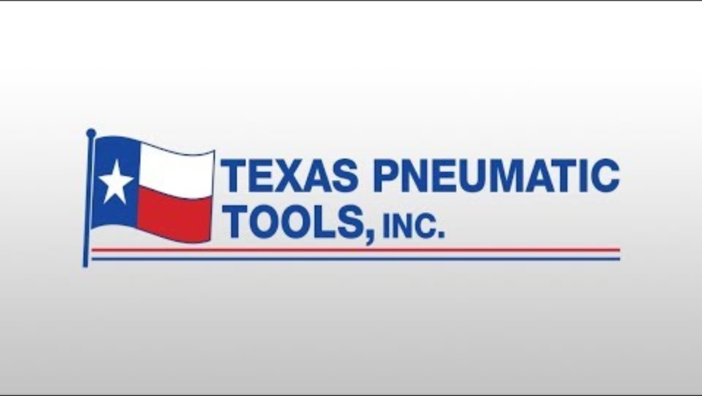

Slide 15
Isolation methods with valves
Terms:
  Block vs. Isolation
    Every valves blocks, but only trunnion ball valves with DPE seats can isolate
    Isolation: guarantee that no energy or flammable material will reach the work area.
Valve types
  Plug valves and isolation limitations
  Ball valves
    Floating Ball valves vs. Trunnion
    Trunnion seat designs – SPE/DPE
    DIB-1, DIB-2, DBB
    Marking

Slide 16
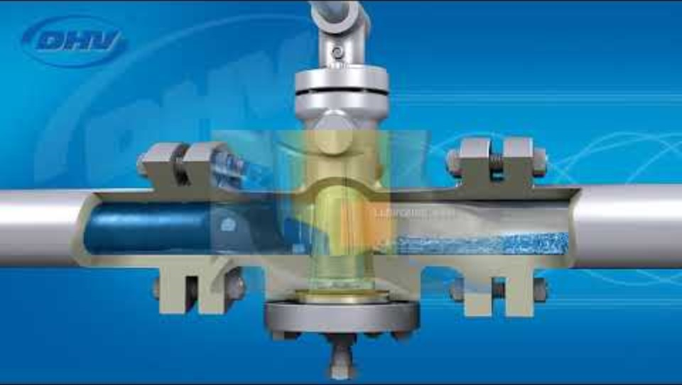
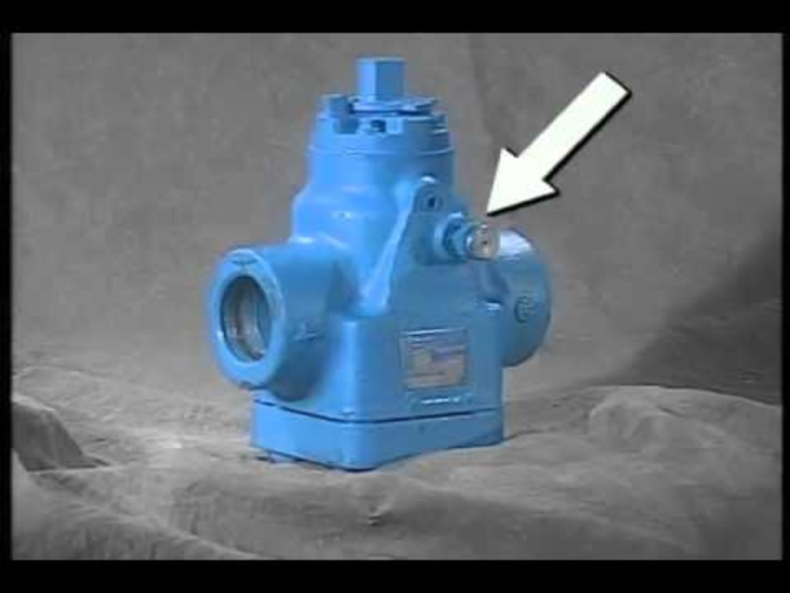
Plug valves
Plug valves use a machined, conical plug that rotates 90 degrees to shut off flow.
Close machining tolerances and use of a viscous, clay-based grease provide the seal in the metal-metal interface between the valve body and the plug.
Plug valves do not use elastomeric materials to provide seal.
  The metal-metal sealing design makes plug valves ideal for throttling during purge and equalization operations. DO NOT throttle a ball valve.
Sealing issues: If the valve isn't greased on a periodic basis, the grease hardens in the channels and prevents new grease from pushing through. It can also harden in patches in the interface between the body and the plug, creating areas where the grease cannot provide a seal, then gas can slip by.
Single plug valve isolation is NOT suitable for hot work because the grease can let loose during the hot work and suddenly create a potentially explosive mixture in the downstream piping.
Additionally, there is no second sealing surface or body vent to capture and vent leaking gas. Compare to DPE ball valves.
If valve leaks—lubricate valve and operate several times, inject valve cleaner to dissolve old grease, adjust plug height using adjustment screw on the bottom of the valve.
YouTube Links:
DHV Plug Valve Overview
Nordstrom Rockwell valve maintenance

Slide 17
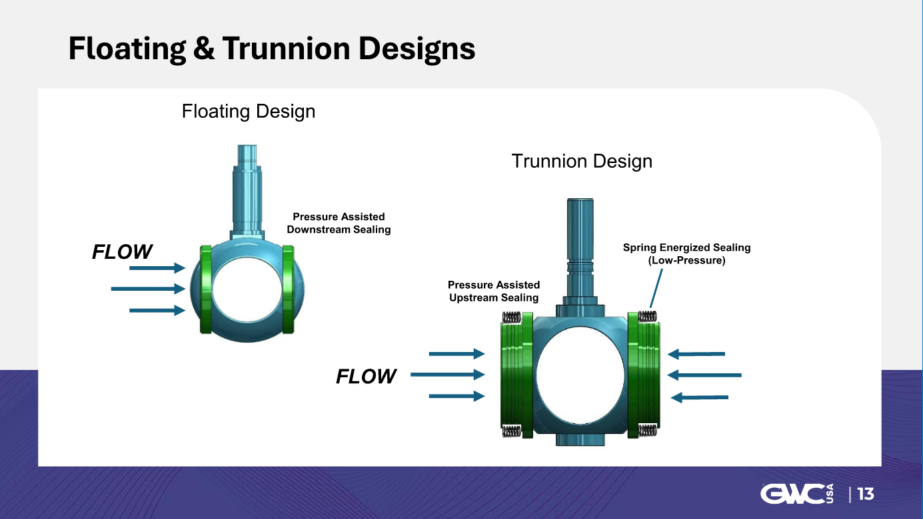

Slide 18
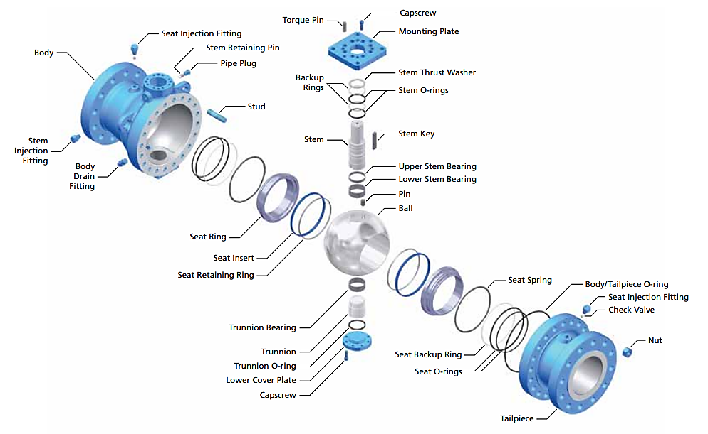
Ball Valves
Trunnion vs. Floating ball valves Install trunnions only (except <2”)
Trunnion ball valve has fixed axis of rotation, seat rings pressed against ball with springs
Seat rings have elastomeric O-ring seals to provide primary sealing surface
Body is tapped with a drain fitting to bleed down cavity pressure
Seat injection fittings provide way to lubricate or flush the seats
Never throttle a ball valve! High velocity gas will erode the elastomeric seat and seal material, permanently damaging the valve.

Slide 19
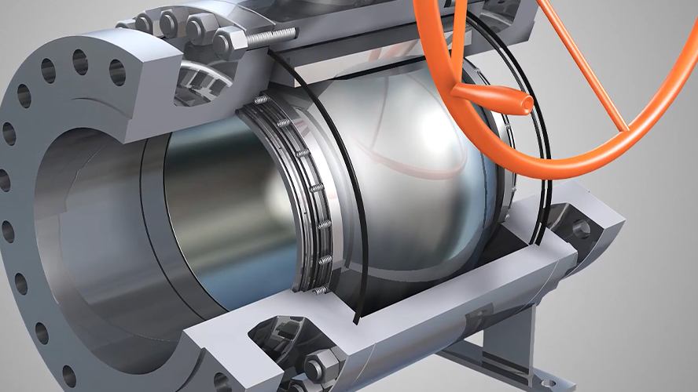

Slide 20
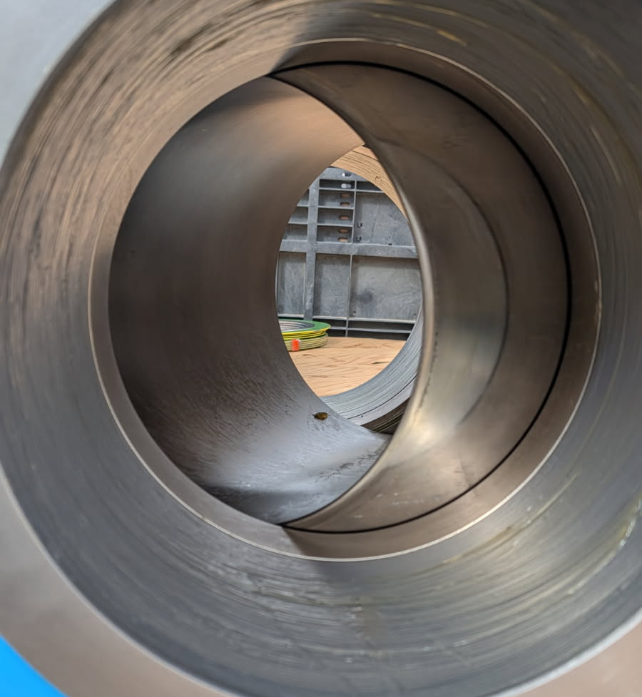
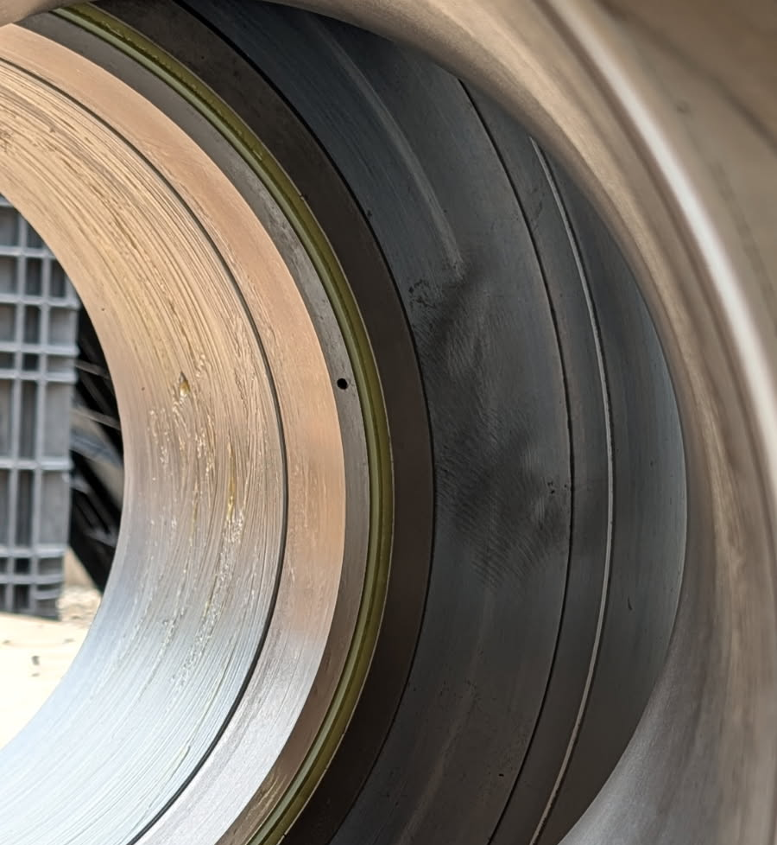
Lubrication port
Seat Ring
O-Ring Seal
Seat Ring

Slide 21
Single Piston Effect Seats
Seat rings in ball valves move toward or away from the surface of the ball – piston action
Two different seat designs: Single Piston Effect and Dual Piston Effect
SPE: AKA self-relieving or unidirectional seats
  Only seals on the upstream, pressurized side of the valve
  Gas pressure from the pipeline can go behind the seat and assist the springs to press the seats against the ball
  Any cavity pressure in the valve body can be relieved downstream (work area) once the cavity pressure exceeds the spring pressure in the downstream seat
  Not suitable for hot work with single valve isolation. Requires additional block valve or use of air mover.

Slide 22
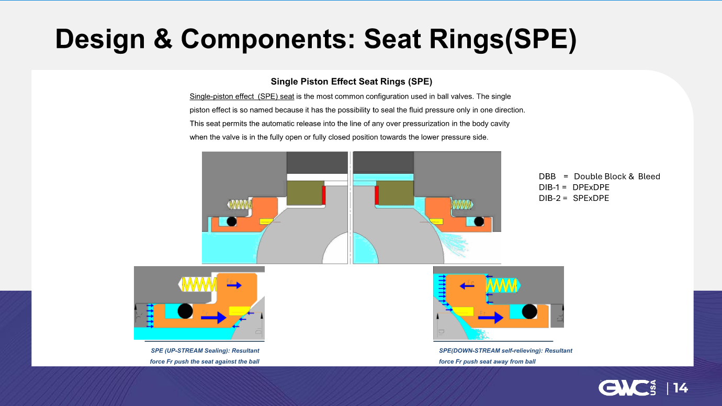

Slide 23
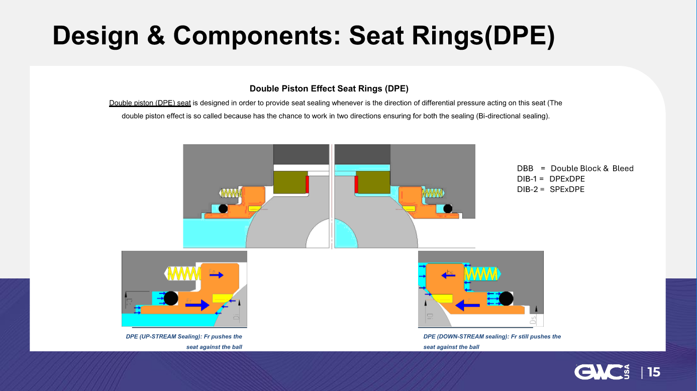

Slide 24
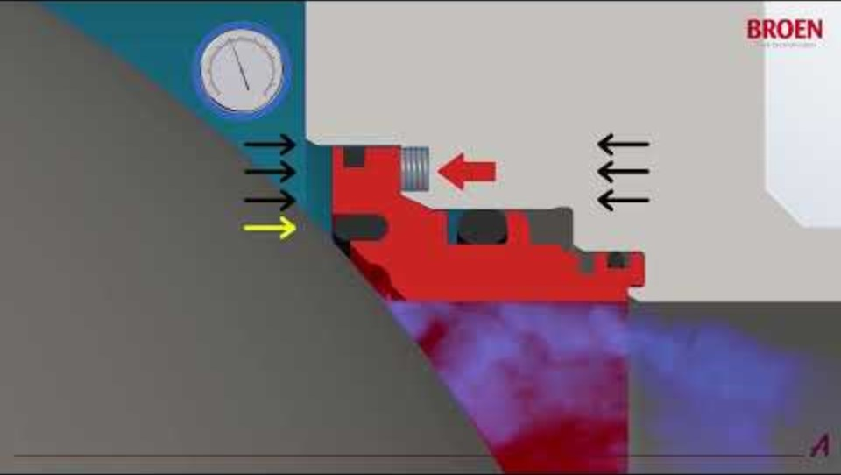

Slide 25
Positive Isolation: Single valve with DPE seats and body bleed
DPE: AKA non-self relieving or bidirectional seats
  Seal on both the upstream and downstream seats
  Similar to SPE, will use pipeline pressure to push upstream seal against the ball
  Additionally, any cavity pressure in the valve body goes behind the downstream seat and assists the downstream seat in sealing against the ball.
  Suitable for hot work with single valve isolation, but requires continuous monitoring of the body bleed while work is completed
A trunnion valve will have a body bleed, regardless of seat design. But only DPE valves are allowed for single valve isolation in case the upstream seal leaks more than what the body bleed can vent (especially if a hose is installed to redirect leaking gas away from the work area). With DPE, any accumulating pressure would assist the downstream seat to seal better.

Slide 26
DBB vs DIB-1 vs DIB-2
Double Block and Bleed
  API 6D - One trunnion ball valve with two Single Piston Effect Seats
    Not Isolation!
  OSHA - two valves of any type with a valve in between to vent
    Isolation!
Double Isolation and Bleed 1
  One type of seat, two Dual Piston Effect seats
  Bidirectional Isolation - Provides positive isolation in two directions
  DIB-1 – Premium, #1 best way to provide isolation
Double Isolation and Bleed 2
  Two types of seats, one DPE and one SPE
  Unidirectional Isolation – only provides positive isolation when DPE seat is downstream

Slide 27
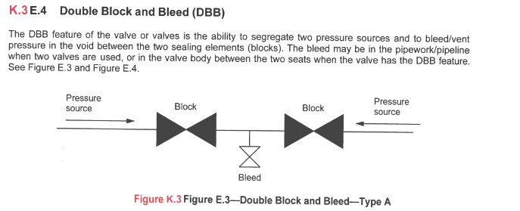
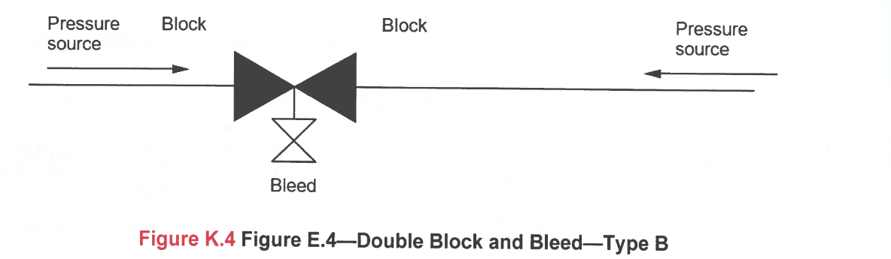
API Block, Bleed, and Isolation Definitions
Downstream
Upstream
Upstream

Slide 28
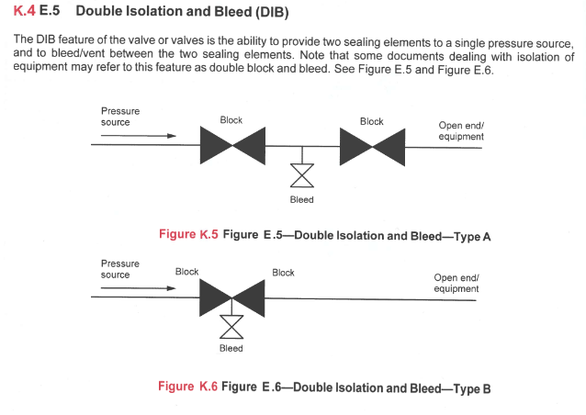
API Block, Bleed, and Isolation Definitions
Compare to OSHA’s definition of DBB
Upstream
Downstream
Upstream
Downstream
Valves with DPE seats

Slide 29
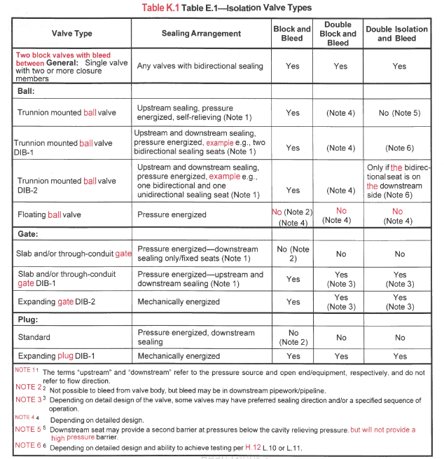
Table from API 6D describing isolation valve types

Slide 30
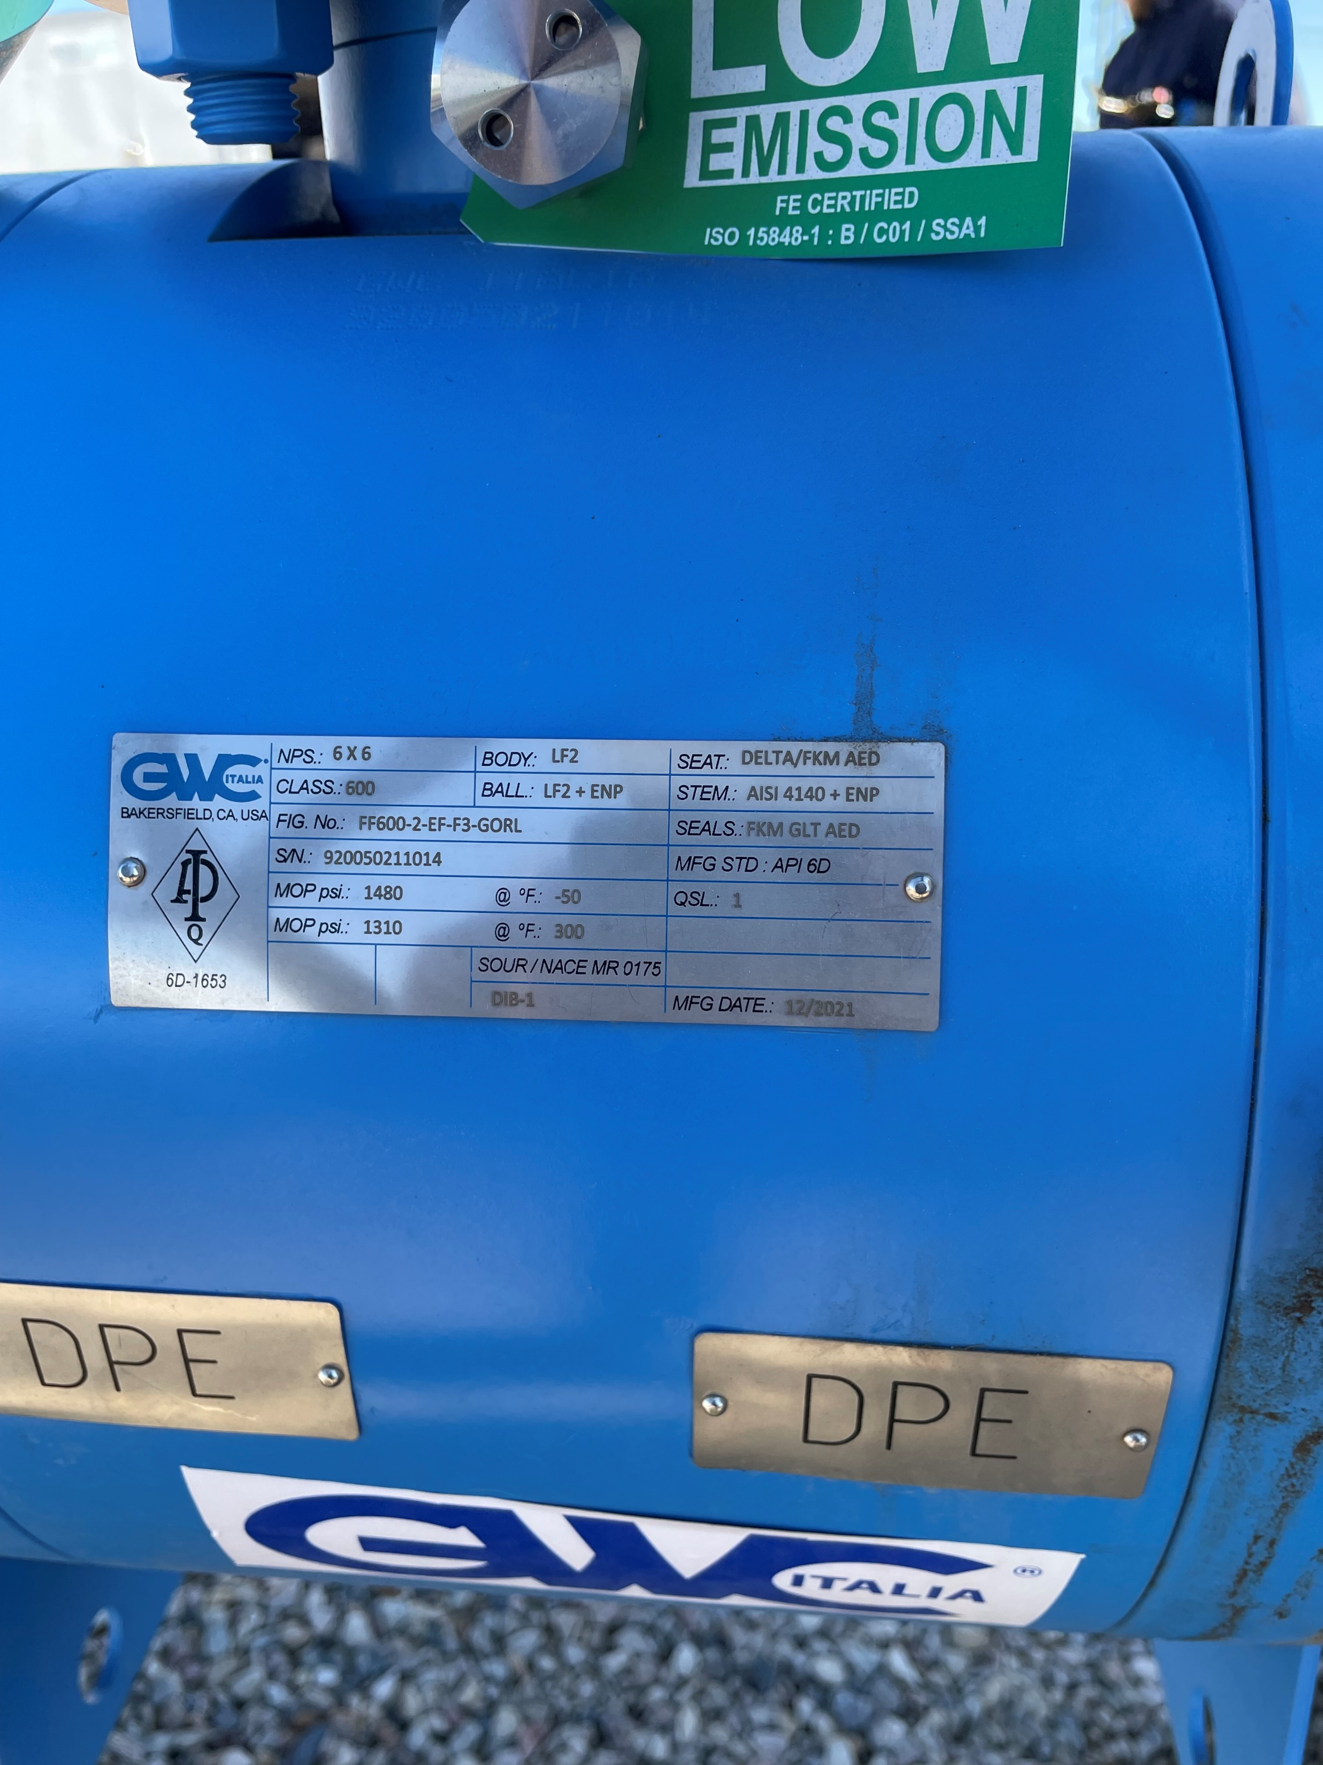
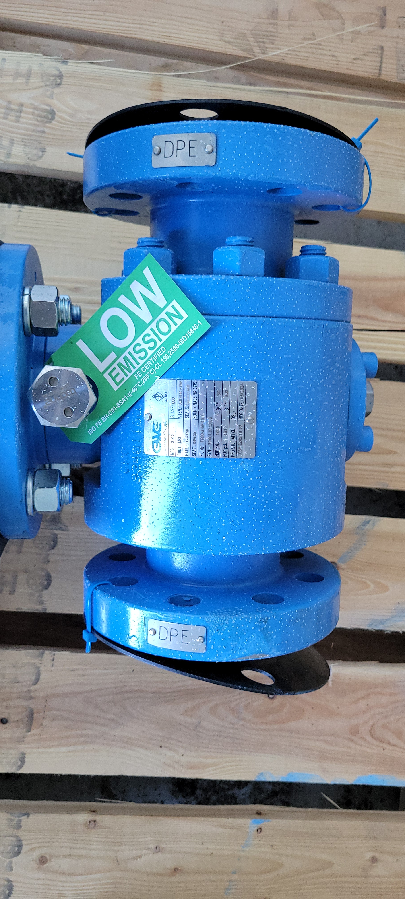
Valve Seat Marking
API 6D requires seat design to be marked on the valve
  Check the nameplate tag for DBB, DIB-1, DIB-2
If DPE marking is not visible on the valve, assume seats are SPE and adjust method of positive isolation

Slide 31
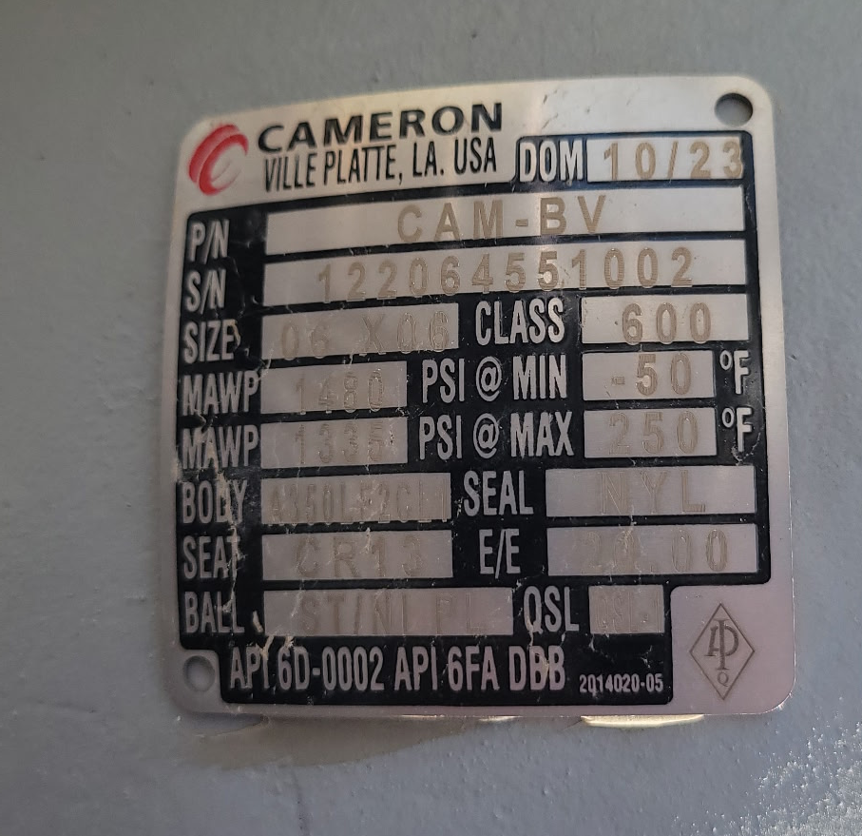
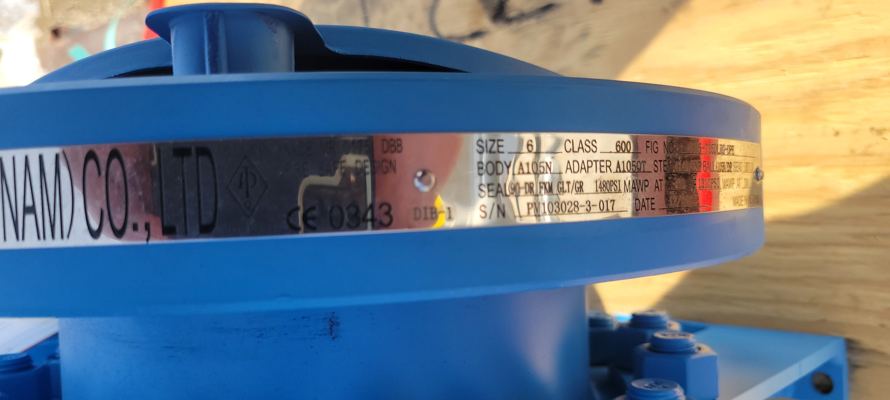
Valve Seat Marking Examples

Slide 32
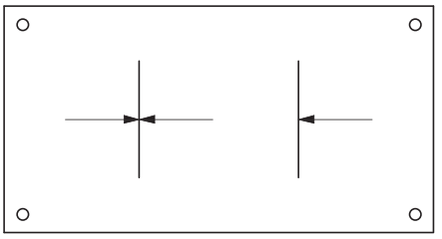
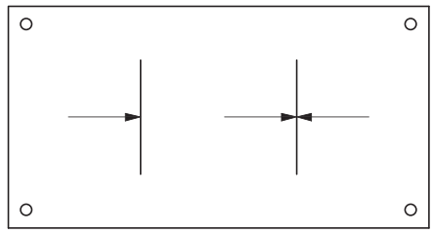
Double Block & Bleed (DBB)
Design: The DBB Design utilizes 2 single piston effect seats (SPE). The SPE seat is energized by the incoming line pressure and only holds pressure in one direction. The downstream seat is not energized. If excess pressure builds in the ball cavity, it is relieved inside the pipe to the low-pressure side.
A
B
Drawback – Only one seat is energized during operation. If this seat becomes damaged, it will result in leakage through the valve because the downstream seat is not energized. Cavity relief can occur in either direction, which may not be the desired result for the operator.
Unidirectional Seat
(Relieving seat)
(SPE seat)
Unidirectional Seat
(Relieving seat)
(SPE seat)

Slide 33
Double Isolation & Bleed (DIB-1)
Design: The DIB-1 Design utilizes two double piston effect seats (DPE). The DPE seats are always energized and provides a double seal in both directions. If excess pressure builds in the ball cavity, it must be relieved externally from the valve through a pressure relief system.
A
B
Drawback – This design does not relieve excess pressure within the ball cavity inside the pipeline. An auxiliary system must be utilized to relieve pressure outside the valve, typically through a pressure relief valve mounted in the vent connection.
Bidirectional Seat
(NON-Relieving seat)
(DPE seat)
Bidirectional Seat
(NON-Relieving seat)
(DPE seat)

Slide 34
Double Isolation & Bleed (DIB-2)
Design: The DIB-2 Design utilizes one SPE seat and one DPE seat. The SPE seat is energized by the upstream pressure and the DPE seat is always energized by the seal so the valve has double sealing. If excess pressure builds in the ball cavity, it will relieve internally in the pipeline to the SPE side of the valve.
A
B
Advantage – This design provides the double sealing benefit of the DIB-1 design with the internal cavity relief benefit of the DBB design which insures any pressure relief happens within the piping and does not require an auxiliary system to relieve pressure inside the valve.
Unidirectional Seat
(Relieving seat)
(SPE seat)
Bidirectional Seat
(NON-Relieving seat)
(DPE seat)

Slide 35
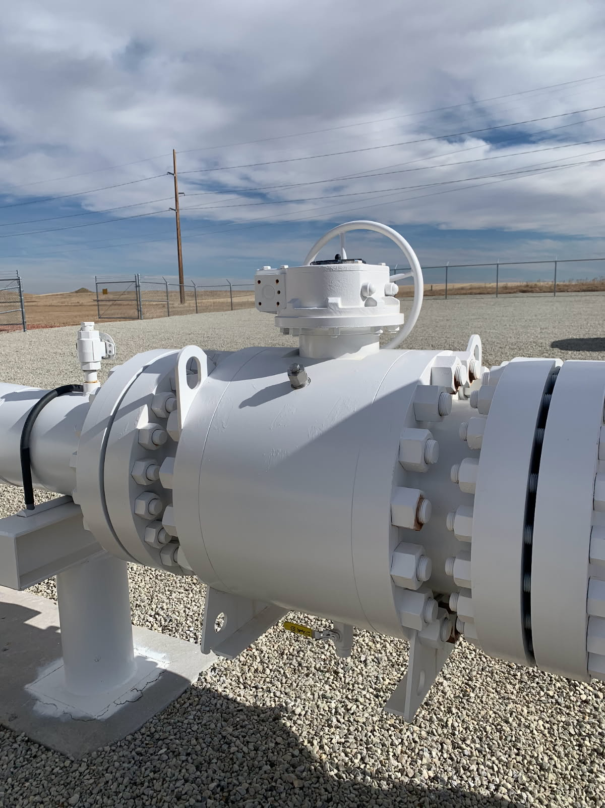
Body Bleed mods
Body relief: API 6D requires DPE valves be shipped with cavity relief valve in case valve is used in liquid service
  API 6D does NOT require the relief valve be installed in gas service
  Recommendation: remove relief valve and install needle valve
Body Bleed: some valves are shipped with plugs or body bleed fittings.
  Recommendation: remove body bleed fitting and install ball valve of same diameter as the body bleed

Slide 36
Thanks for listening to my TED talk
Questions?

