Slide 1
INTRODUCTION
TO
REMOTE MONITORING
Gabriel Gavrielides, P.E.
Sr. Consulting Control Systems Engineer
Instrument, Controls and Electrical, Gas Transmission

Slide 2
Agenda
PG&E GAS System Overview
Remote Monitoring Systems
Gas Telemetry Infrastructure
Supervisory Control & Data Acquisition
TSA Gas Cybersecurity
Q & A Session

Slide 3
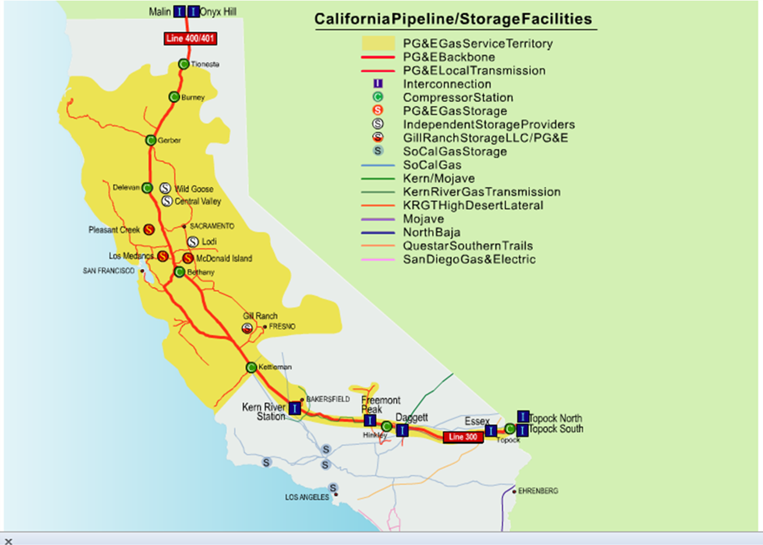
PG&E Gas System
    PG&E operates one of the largest natural gas systems in the United States, covering a service area of approximately 50,000 miles of Gas Transmission and Distribution network.

Slide 4
Remote Monitoring
    Remote monitoring in Gas T&D ensures the safe, reliable and efficient delivery of gas by providing real-time visibility to Gas Control, Planning, and Operations. This digital infrastructure enables:
    Continuous data acquisition (e.g.. Pressure, Flow, dP, Temperature, Odorant levels, Valve position etc)
    Alarm management
    Remote parameter adjustments
    Automated equipment sequencing
    Asset Health tracking
    Historical data logging for regulatory compliance and optimization.

Slide 5
Remote Monitoring Systems
    RTU (Remote Terminal Unit)
    PLC (Programmable Logic Controller)
    DCS (Distributed Control System)
    WirelessHART (Gateways & Mesh Networks)
    SCADA (Supervisory Control And Data Acquisition)
      Remote: Gas Control
      Local HMI: Critical manned facilities.
Facility Type | Operational Function | System Type
Distribution Regulating Stations | Monitoring | RTU, WirelessHART
Transmission Regulating Stations | Monitoring / Control | RTU
Terminals/Interconnects | Monitoring / Control | PLC
Compressor Stations | Monitoring / Control | PLC
Underground Storage Facilities | Monitoring / Control | DCS, PLC, WirelessHART
Pressure Limiting Stations | Monitoring / Control | PLC, RTU
Pipeline Rupture Control Valves | Monitoring / Control | RTU
Transmission Pipeline Visibility | Monitoring | RTU, WirelessHART
Biomethane Projects | Monitoring / Control | RTU

Slide 6
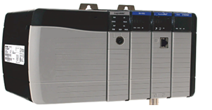
Programmable Logic Controller
  Key traits:
    Real-time Performance: Deterministic processing with very fast response time regardless of network load.
    Modular Scalability: Supports high density, hot-swappable I/O.
    System Resiliency: Redundant CPU/Power configuration for fault-tolerant operation.
    Advanced Control: Executes complex PID loops and sequencing.
    Integrated Security: CIP-compliant hardware to safeguard against unauthorized control access.

Slide 7
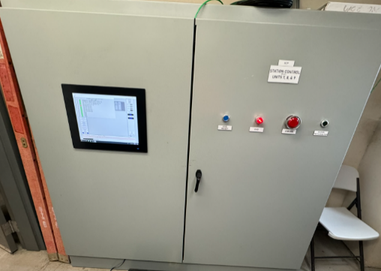
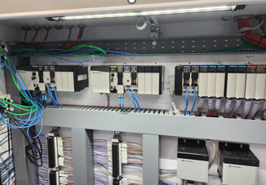
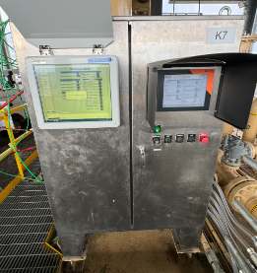
Programmable Logic Controller
  PG&E Deployments:
    Station Level: Deployed at complex stations such Compressors, Terminals, and Pressure Limiting Stations.
    Unit-Level: Specialized control for VFDs, Glycol Regenerators, and ATS.
  SCADA Integration:
    Local (Station HMI): Aggregates data from PLCs via OPC UA protocol.
    Remote (Gas Control): Communicates via Modbus TCP over PG&E’s private Gas Data Network (GDN).
PLC rack
Station Control Panel (SCP)
Unit Control Panel (UCP)

Slide 8
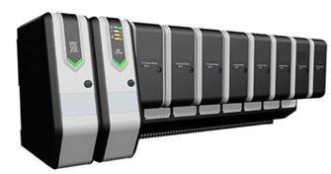
Distributed Control System
    Key traits:
      Unified Database: A DCS uses a single, global database when creating tags in the controller.
      Plant-Wide Integration: Unlike the “piecemeal” approach of a PLC, a DCS is designed as one cohesive ecosystem from a single vendor.
      Asset Management: It includes tools to monitor health and calibration of field instruments (via HART or Fieldbus) directly from the engineering workstation.
      Advanced Process Control: Optimized for complex PID loops, tuning, predictive modeling, making it superior for continuous processes.
      Seamless Online Updates: A DCS is built to allow logic updates and hardware swaps while the plant is running.

Slide 9
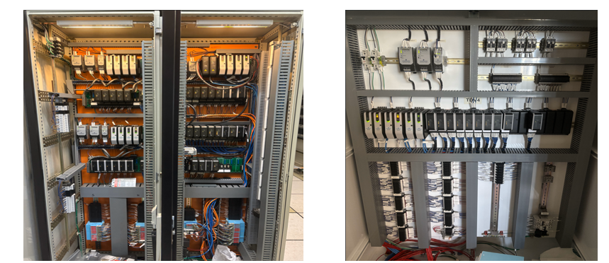
Distributed Control System
    PG&E Deployments:
      Complex Station: Deployed at a single Underground Storage Facility.
    SCADA Integration:
      Local (Station HMI): Aggregates data from the DCS via OPC UA protocol.
      Remote (Gas Control): Communicates via Modbus TCP over PG&E’s private Gas Data Network (GDN).
DCS Controllers 1-3
DCS Controller 4

Slide 10
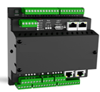
Remote Terminal Unit
  Key traits:
    Ruggedized: Built to withstand extreme temperatures and harsh environment to resist dust and moisture.
    Energy efficient: Designed to run on low-power making them ideal for remote sites powered by small solar arrays or UPS .
    Streamlined Logic: Use standard ladder logic programming language so technicians can easily troubleshoot them in the field.
    Minimal Maintenance: No moving parts, designed for long reliability over time.
    Scalability: Provides cost-effective remote monitoring and control, reducing the need of expensive hardware (e.g. PLCs).
  PG&E Deployments:
    Deployed at Transmission and Distribution regulating stations and on Transmission pipeline rupture block valves.
  SCADA Integration:
    Remote Supervision (SCADA): Communicates over licensed MDS Radio OR Cellular modem to Gac Control.
    Communication Protocol: Utilizes Modbus RTU for robust SCADA reporting.

Slide 11
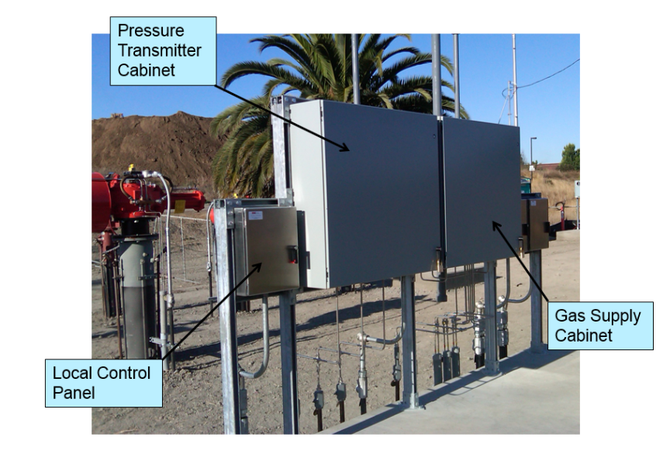
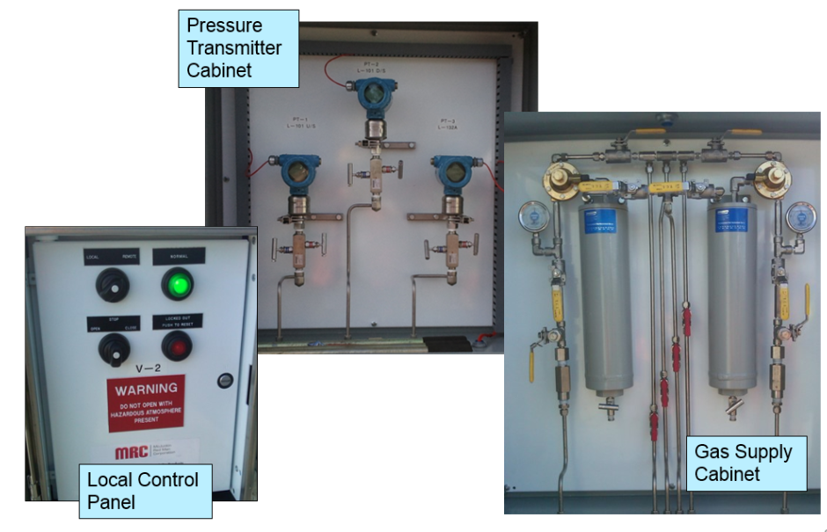
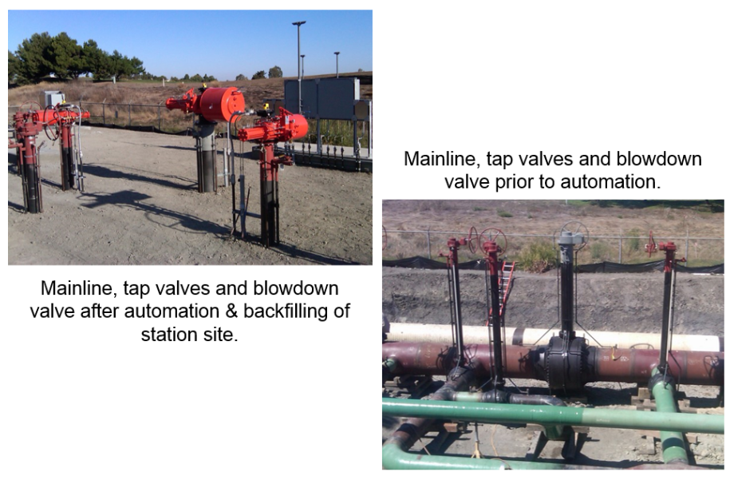
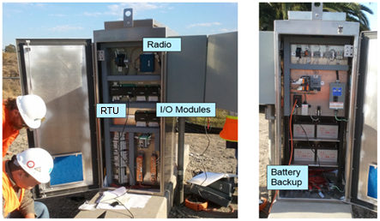
RTU in Transmission
Transmission Line Rupture Control:

Slide 12
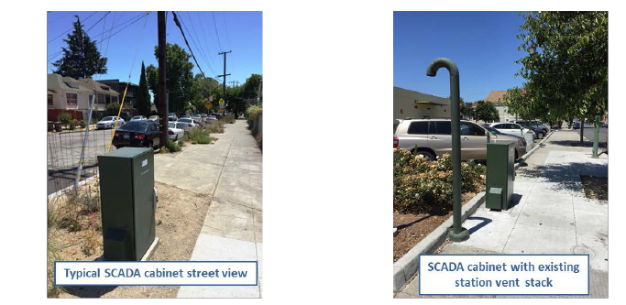
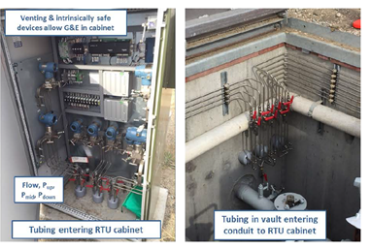
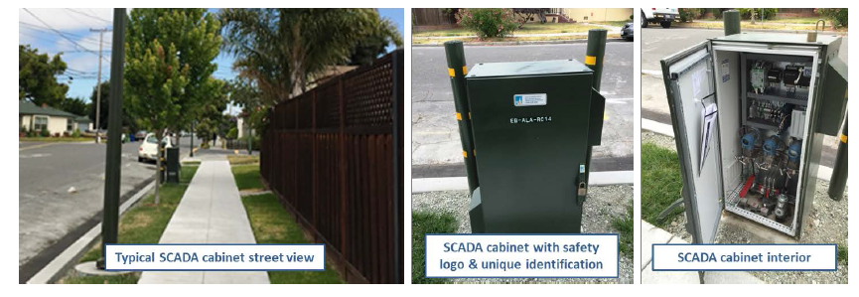
RTU in Distribution
Distribution Regulating Stations:

Slide 13
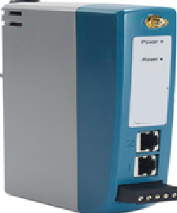
WirelessHART
  Key traits:
    Self-Organizing Mesh Network: Automatically discovers neighbors and adjust communication paths (e.g. self-healing if a signal is blocked or devices fails).
    High Reliability: Achieves 99.9% uptime by using redundant paths and frequency hopping to overcome interference from other wireless signals.
    Ultra-low Power Consumption: Optimized from battery-powered field devices, with many sensors achieving 5-6 years if battery life.
    Highly Scalable: Each standard Gateway supports up to 100 field devices,
    Robust Security: Features multi-tiered, 128-bit AES encryption and device authentication.
    Cost Effective: Adding new measurement points when trenching for new conduit (e.g power/communication) is too expensive or physically impossible for traditional hardwired systems.
    WirelessHART is an approved wireless sensor networking technology based on IEC communication standard (Highway Addressable Remote Transducer Protocol) used for industrial process measurement applications.
    Point-to-Point broadcast range up to 1500 ft with unobstructed line-of-sight.
    PG&E has been utilizing WirelessHART technology for over13 years.

Slide 14
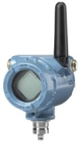

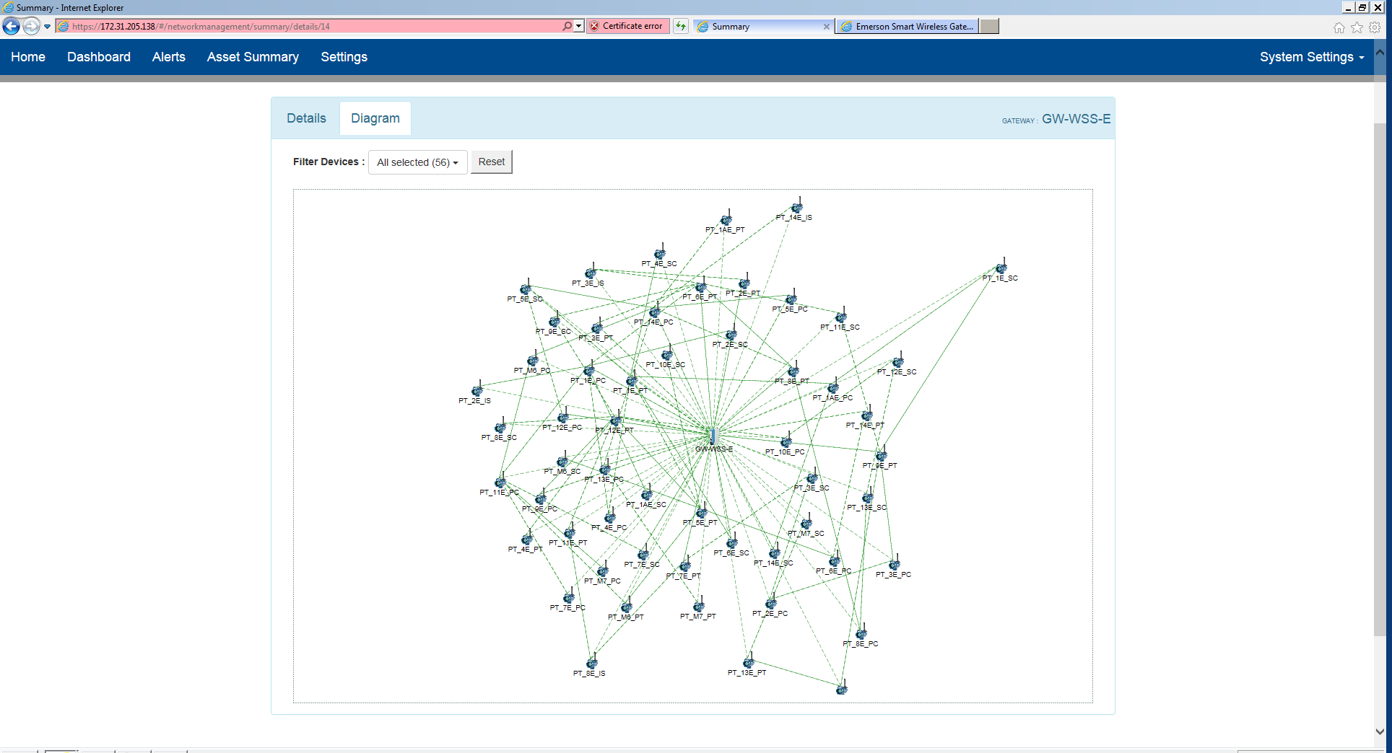
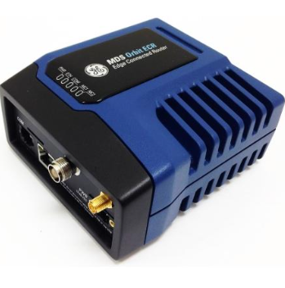
WirelessHART
  PG&E Deployments:
    Deployed at Underground Storage facilities to monitor well pressures.
    Over 100 units deployed at Transmission and Distribution stations.
  SCADA Integration:
    Local Supervision: Station HMI aggregates data from the Gateway via OPC DA protocol.
    Remote Supervision (SCADA): Communicates over licensed MDS Radio OR Cellular modem to Gac Control via Modbus RTU protocol.
Wireless Pressure Transmitters
    Transmitters process data without wires.
HMI
Ethernet (OPC DA)
RS-232
(Modbus TCP)
MDS Radio
Wireless Mesh Topology
SCADA
Wireless Gateway

Slide 15
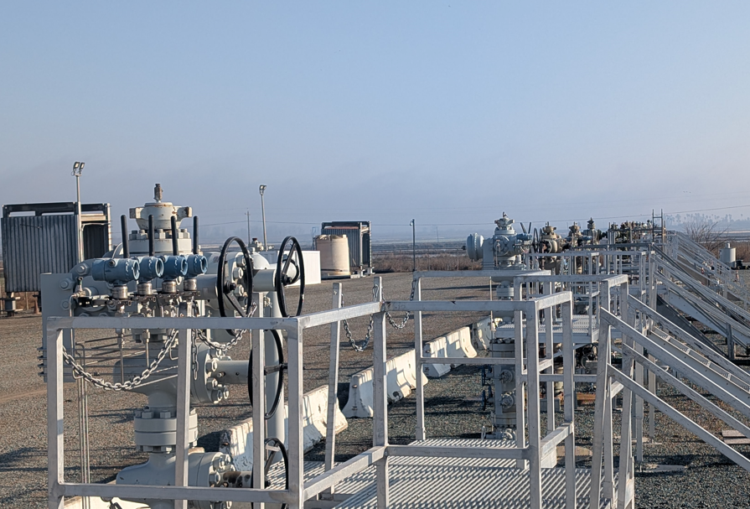
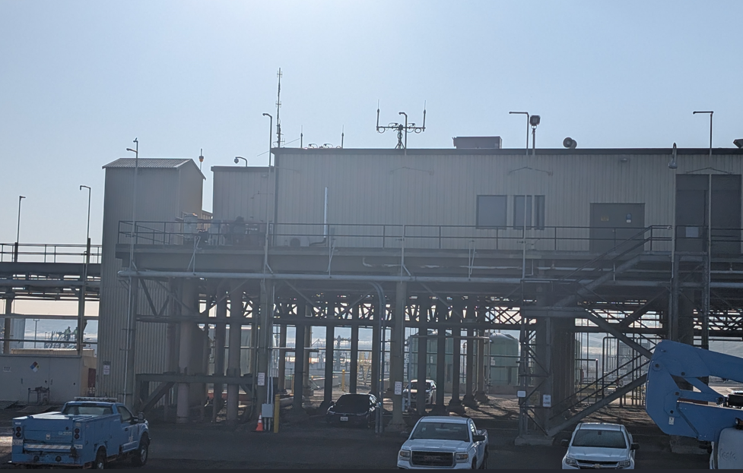
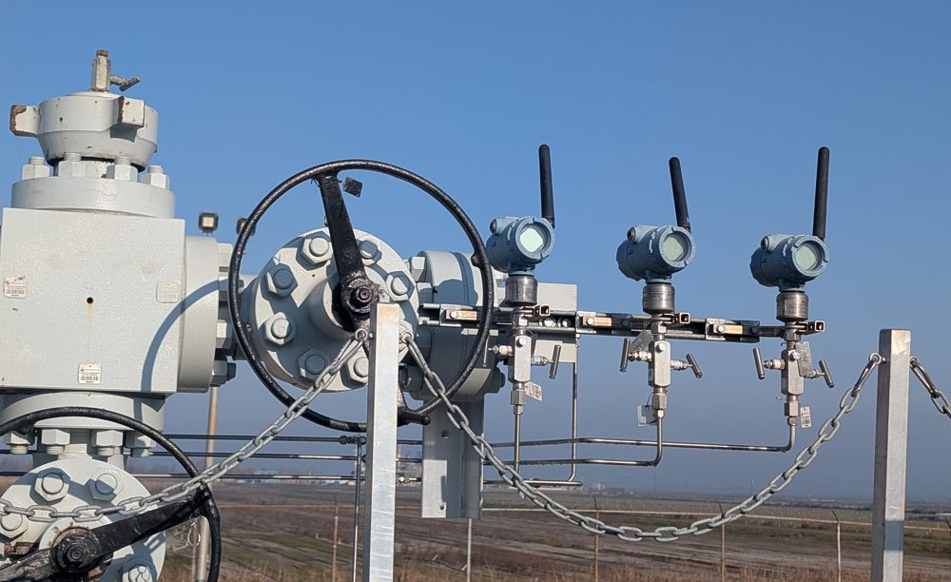
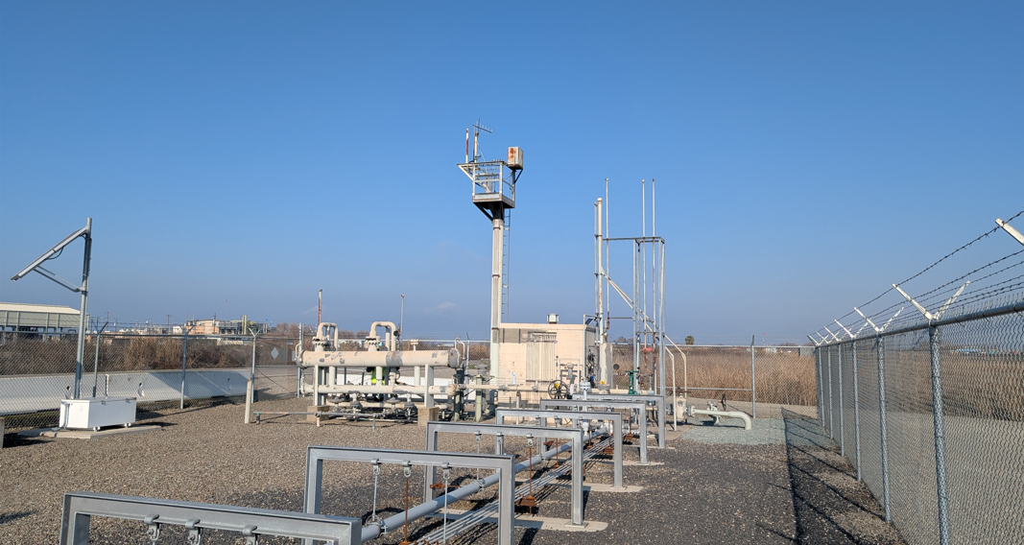
WirelessHART in Storage (Wellheads)
Storage Facility Wellheads
Redundant Gateway antennas for WirelessHART Network
Well Pressure Monitoring
Outer Well Monitoring

Slide 16
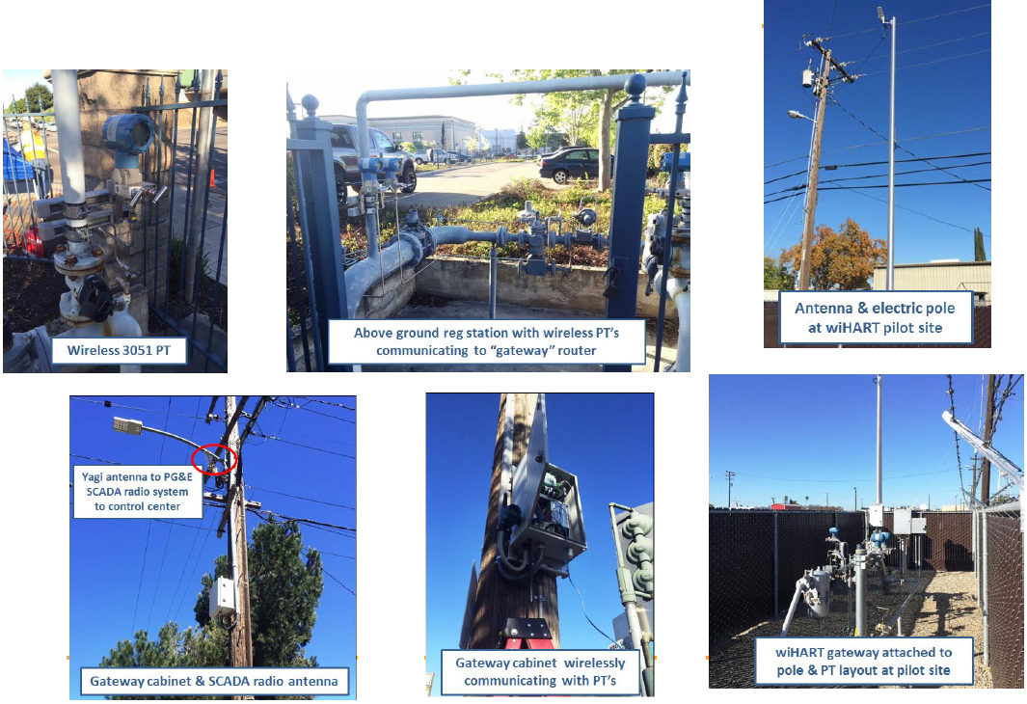
WirelessHART in Distribution
Notes:
production.

Slide 17
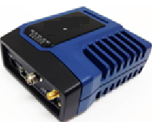

Gas Telemetry Infrastructure
    Microwave (MAS Radios):
      Operating on a licensed 900Mhz spectrum, ensures a private network protected from public interference.
      Point-to-multipoint architecture from high-elevation master sites (like mountain top) ensures reliable polling from Gas Control (SCADA).
      Utility-owned infrastructure eliminates reliance on 3rd party services provides for uptime and critical controls.
    Cellular (4G/LTE Modem):
      Provides an alternative communication link for sites lacking MAS radio coverage, or servers as a redundant backup for critical unmanned sites.
      Leverages commercial LTE networks (i.e. Verizon) to maintain visibility.
      Depends on the coverage footprint and reliability of the service provider.
S

Slide 18
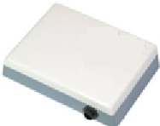
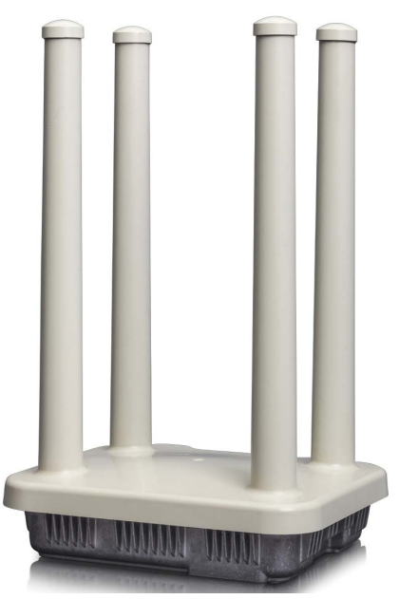

Gas Telemetry Infrastructure
    Satellite (L-band):
      New technology, eliminates communication issues in ultra-remote locations where microwave and cellular line-of-sights are impossible.
      L-band frequency (1.6GHz) is highly resistant to weather conditions and terrain, ensuring continuous SCADA polling.
      More reliable than cellular, but more expensive.
    FAN (Field Area Network):
      Modern utility network for highly localized dense device communication.
      Acts as a wireless mesh router, extending the coverage at wide-area facilities and eliminating the need to use multiple radios or trench for fiber optic cable.
    Fiber Optic (GDN):
      The gold standard for major manned stations such as compressors and storage facilities for ultra-low-latency, and massive bandwidth communication.
      Provides maximum security and is completely immune to EMI or RF signal degradations.
      Very expensive to implement, requires infrastructure.
S

Slide 19
Gas Telemetry Infrastructure
Technology | Architecture | SCADA Poll Rate (Remote) | SCADA Poll Rate (Local) | Comm. Protocol (Remote) | Comm. Protocol (Local) | Field Device
Fiber Optic | Physical (glass) | 5 seconds | Very fast (1 second) | Modbus Sockets, Modbus (TCP | OPC UA, Modbus RTU | PLC, DCS
Microwave | MAS (900MHz) | 20 – 200 seconds | N/A | Modbus RTU | N/A | PLC, RTU, WirelessHART
Cellular | Public Carrier (LG/LTE) | 10 seconds | N/A | Modbus RTU | N/A | PLC, RTU, WirelessHART
Satellite | L-Band | N/A | 5 – 60 seconds | N/A | Modbus TCP, OPC DA | Dataloggers, WirelessHART.
FAN | Wireless Mesh | N/A | 5 – 30 seconds | N/A | Modbus TCP, OPC DA | Dataloggers, WirelessHART.
S

Slide 20
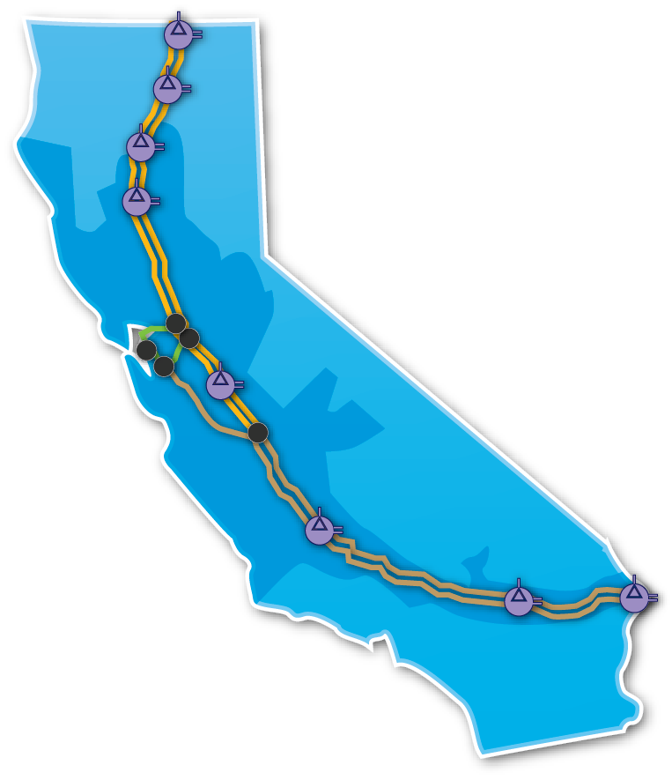

SCADA – Remote (Gas Control)
San Ramon
Primary Gas Control Facility
S
Enterprise SCADA
Gas Control monitors T&D Gas system 24/7
Respond to alarms and emergency calls
Dispatch repair crews to unmanned stations.

Slide 21
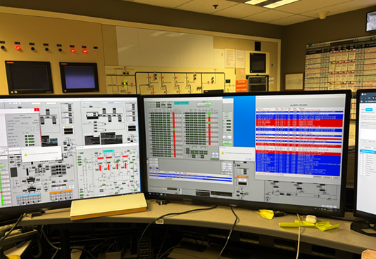
SCADA – Local (Manned Facilities)
S
Local HMI
Operators monitor entire facility 24/7
Respond to alarms and Gas Control calls
Create repairs orders for station technicians

Slide 22
TSA Gas Cybersecurity Compliance
  Transportation Security Administration (TSA) issued two directives in mid-2021 directing the nation’s 100 most critical owners and operators of natural gas pipelines to take certain actions in response to Colonial Pipeline incident.
  PG&E Gas has its own program to comply with the SD-02D directive:
  Field patching and password updates​ for automation controllers and any end devices in the network.
  Performed throughout the year and it requires clearances at individual sites.
  Monitor automation software for vulnerabilities.
S

Slide 23
Q&A Session

