Slide 1

Practical Selection and Usage of Coriolis Meters for Gas Measurement
Marc Buttler
Application Innovation Director
Micro Motion Coriolis Flow and Density Products

Slide 2
Agenda
 | Introduction and Principle of Operation
 | Industry Standards
 | Calibration
 | Maintenance Best Practices
 | Application Selection and Volume Conversion
 | Meter Sizing and Installation Considerations
 | Typical Applications

Slide 3
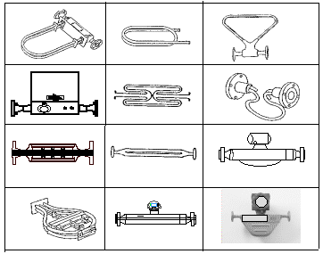
Overview of Coriolis Meters

Slide 4
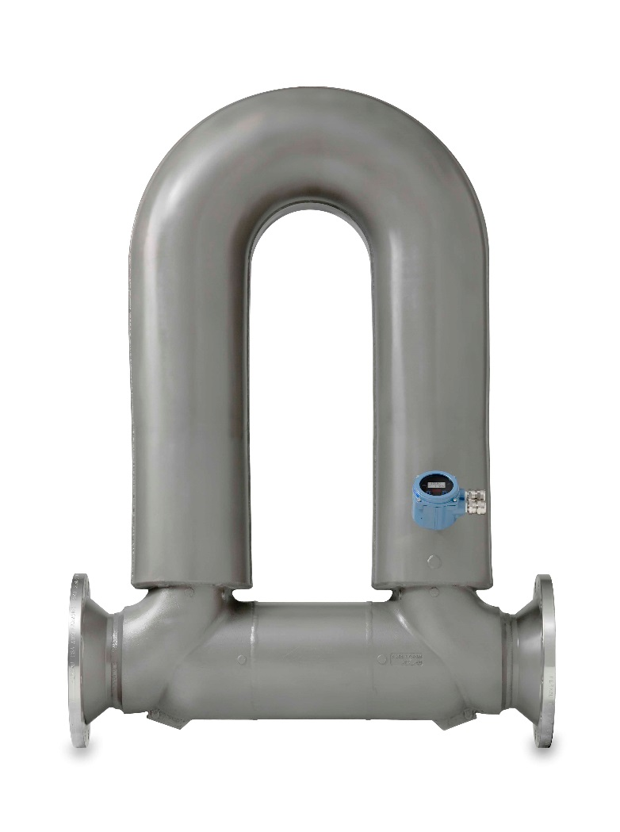
Coriolis Flowmeter Pros and Cons
Key Advantages
Best-in-class direct mass flow, volume flow, and/or density measurement
Non-obstructed flow path
No moving parts
Low / No maintenance required
No flow conditioning or straight runs required
Can provide limited multiphase flow measurement
Excellent repeatability and turndown
Advanced diagnostics to monitor meter AND process health
Some Constraints
Not for line sizes over 16 inches in diameter
Large external meter envelope
Some designs result in high pressure drop at high flowrates
Not as suitable as a Multi-Phase Flow Meter
  Wet gas above Lockhart-Martinelli Parameter 0.75
  Entrained gas in liquid Gas Void Fraction above 15% by volume

Slide 5
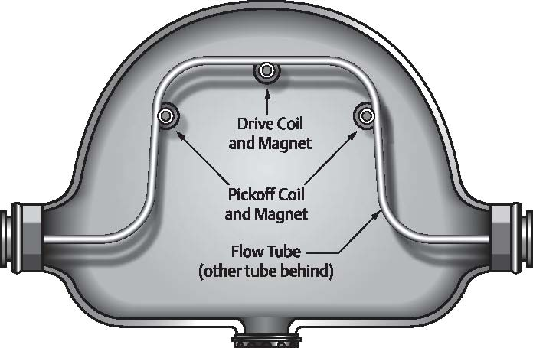
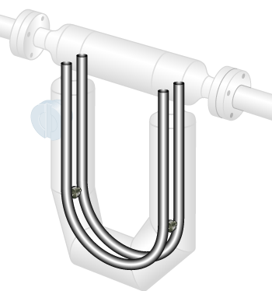
Principle of operation - Bent Tube Meter Design
Flow Direction

Slide 6
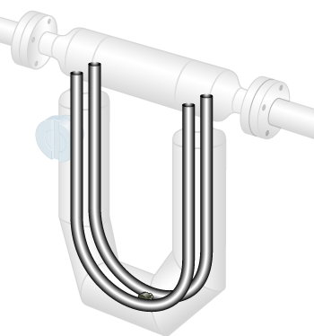

Principle of Operation
Process fluid enters the sensor and flow is split
with half the flow through each tube
Drive coil vibrates tubes at natural frequency
Pick-off coils on inlet and outlet sides generate raw measurement signals
X

Slide 7
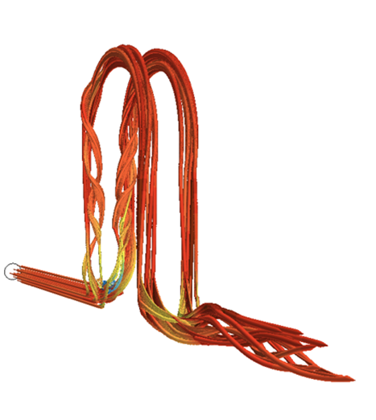
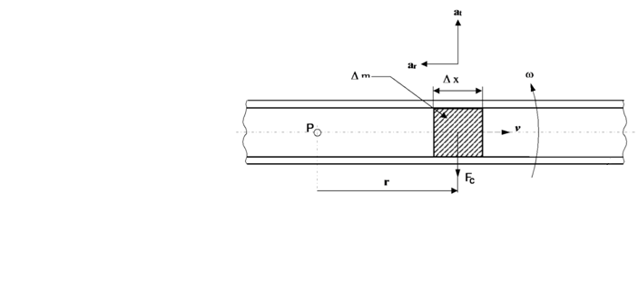
Coriolis Meter Principle of Operation
Physics of Coriolis Force
That Creates Twist During Flow
Coriolis Principle: As a mass moves toward or away from the center of rotation (P) inside a rotating tube, the particle generates inertial forces on the tube.
A Coriolis meter measures mass directly
Measurement is not affected by changes in fluid properties and velocity profile
Notes:
It is not necessary for a Coriolis meter to make the flow tubes rotate in just one direction. Just by vibrating the tubes constantly, the meter creates rotation back and forth as shown by the motion of the diagram
To see Coriolis force at work, observe the twisting and turning travel of the ball as these children play on a rotating carousel. Due to the rotation of the Earth, Coriolis forces make a hurricane spin and it is also a major factor in the accuracy of long-range artillery fire. In the diagram shown are the elements of how Coriolis force works on the flow tubes of a Coriolis meter. The force that acts on the tube is due to the inertia of the mass of the fluid as it passes through the tube, but that is not all. It is the combination of a rotation of the flow tube about the fixed point ‘P’ as the mass either moves towards or away from the center-point ‘P’ that is critical. The resulting Coriolis force is the cross product of the velocity vector of the mass shown here as ‘v’ and the angular momentum vector omega that points straight out from the page. As the cross product it is perpendicular to both , and so it will be straight down as shown in the diagram here as ‘F sub c’.
[CLICK]
This is a little easier to visualize if we animate the angular momentum so that the tube is rotating like the carousel. Note that as the mass is moving out from the center, the Coriolis force is fighting against the direction of the rotation. However, if the mass flowing inside the tube were to change direction and started flowing the opposite direction toward the center of rotation, the Coriolis force would also switch direction to be straight up, which is in the SAME direction as the rotation. This will become important later.
[CLICK]
How does this relate to the vibrating tubes of a Coriolis meter, you may ask? Looking at this animation with the vibrating tubes, note that while the tubes are moving from one side to another, they are both actually rotating momentarily like the rotating tube in the diagram with the center point ‘P’ being at the axis of the pipeline where the flow is first split and enters the tubes, and then later combined to exit the tubes. Out at the extreme end where the drive coil sits, the rotation is like the far edge of the carousel. This is also where the mass flow of the fluid makes a U-turn and reverts from flowing out toward the edge of rotation back toward the center of rotation.
It is not necessary for a Coriolis meter to make the flow tubes rotate in just one direction. Just by vibrating the tubes constantly, the meter creates rotation back and forth as shown by the motion of the diagram in this new animation.
[CLICK]
The physics of a Coriolis meter are important to understand because they explain why it is the bulk mass flow of the fluid that is being measured and not the volume. It is a very well-understood benefit of Coriolis meters that they can measure mass flow directly and are, therefore, not adversely affected by changes in fluid properties and the condition of the velocity profile.

Slide 8
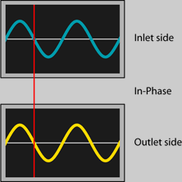

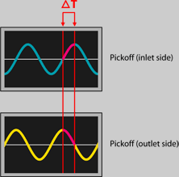
Coriolis Meter Principle of Operation
Signal Processing
No Flow
Flow
Causes
Twist
Isometric View
At No Flow
Notes:
When there is no flow passing through the meter the flow tubes vibrate normally. The tubes are always vibrating whether there is flow through the meter or not. The electronic transmitter is measuring the movement of the tubes in two places with the two pick-off coils that are generating sine waves. When there is no flow through the meter these two sine waves are in synch and will lay on top of each other while the tubes are vibrating normally.
[CLICK]
When flow starts to pass through the meter, the flow tubes begin to twist as you can see in the bottom view. The electronics sees this twisting as a shift in the phase or time delay between the signals coming from the two pick-off coils and we have a mass flow measurement. The mathematics of the signal processing is very simple. The mass flow rate is exactly proportional to the amount of phase or time delay measured between the two pick-off coils. This makes calibration of the meter relatively easy because all that is necessary is to find the single Flow Calibration Factor at any one flow rate and then apply that same factor to the phase shift that is measured at any other flow rates to arrive at a correct flow measurement. Coriolis meters are extremely linear in this regard.

Slide 9
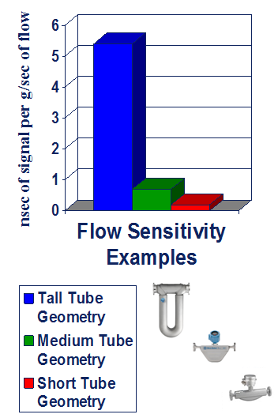

Coriolis Meter Raw Sensitivity
Varies with Design
Raw Sensitivity Depends on Tube Geometry
Signal to Noise Ratio Depends on Raw Sensitivity and Stability
Calibration Flexibility,
Immunity to Secondary Effects, and Diagnostic Capabilities Depend on Signal to Noise Ratio
Notes:
One final note on the physics of Coriolis meters before we move on to talk about how they are used to measure natural gas.
The geometry of the flow tube design is very important. The farther out and then back the fluid travels away from the centerline of the pipeline, the more raw Coriolis flow measurement signal will be physically generated and measured by the twisting of the flow tubes. This is important when you shop and compare flow meters for gas measurement and when you hope to choose the meter type that will give you the best accuracy for custody transfer.
[CLICK]
Raw sensitivity of any Coriolis flow meter depends on how far out the tube geometry extends from the central axis of the pipeline. The chart shows an actual comparison of this relative raw signal between meters with large tall flow tube geometry like Micro Motion ELITE meters and meters with shorter or medium size tube geometry, like Micro Motion F-Series meters.
[CLICK]
Signal to noise ratio of any Coriolis meter will depend on two things. First and foremost, the signal to noise ratio will be higher when raw sensitivity is higher. The stability of the meter signal when the meter is at zero flow will also impact the signal to noise ratio. When stability is better, noise is lower, and the ratio of signal to noise will again see an increase.
[CLICK]
Signal to noise ratio is important because a higher ratio makes it possible for a meter to measure with better precision and accuracy. Higher signal to noise ratio also opens the door to other benefits such as advanced diagnostics, calibration fluid flexibility, and greater resistance to adverse secondary effects due to changing process and ambient conditions.

Slide 10
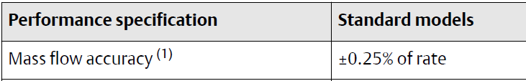
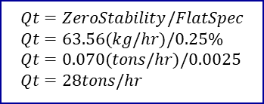
Coriolis Flow Performance –
Zero Stability and Flat Spec or rated accuracy
Example
Calculation of Qt
HC3
$$Qt=ZeroStability/FlatSpec \\ Qt=63.56(kg/hr)/0.25\% \\ Qt=0.070(tons/hr)/0.0025 \\ Qt=28tons/hr$$

Slide 11
AGA Section 6.1
Minimum Performance Requirements

Slide 12
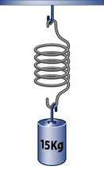
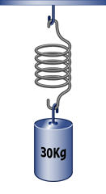
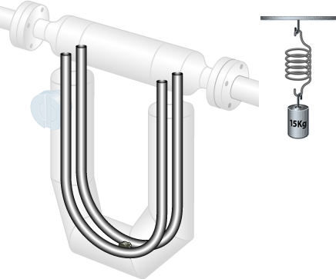
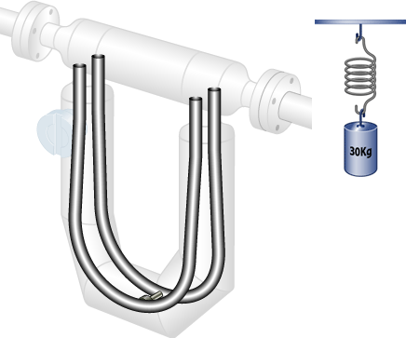
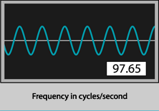
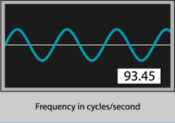
Direct Density Measurement
Density measurement is based on the natural frequency
  As the mass increases, the natural frequency of the system decreases
  As the mass decreases, the natural frequency of the system increases
Notes:
Density measurement is based on the natural frequency of the system including the flow tubes and the process fluid. As the mass increases, the natural frequency of the system decreases. As the mass decreases, the natural frequency of the system increases.

Slide 13
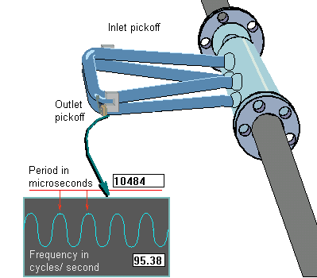
Direct Density Measurement - Gas
Density Accuracy +/- 0.0005 gm/cc
Water Density = 1 gm/cc (potential error = 0.05%)
Natural Gas Density @ 500 psi = 0.0272 gm/cc (potential error 1.8%)
Increasing density may indicate coating or liquids
Clean vs. Dirty
& Meter Health Diagnostic

Slide 14
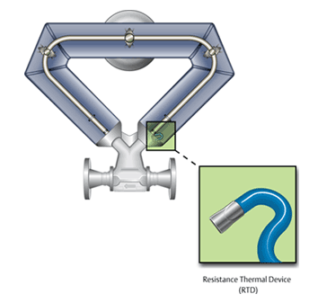
Direct Temperature Measurement
Three wire platinum Resistance Temperature Detector (RTD)
Measures tube temperature on inlet side of sensor
Notes:
15

Slide 15
Agenda
 | Introduction and Principle of Operation
 | Industry Standards
 | Calibration
 | Maintenance Best Practices
 | Application Selection and Volume Conversion
 | Meter Sizing and Installation Considerations
 | Typical Applications

Slide 16
AGA Report Background
AGA Report No. 3
AGA Report No. 4A Invisible word
AGA Report No. 5
AGA Report No. 6 Invisible word
AGA Report No. 7
AGA Report No. 8 Invisible word
AGA Report No. 9
AGA Report No. 10 Invisible word
AGA Report No. 11
Orifice Metering of Natural Gas
Natural Gas Contract Measurement and Quality Clauses
Natural Gas Energy Measurement
Field Proving of Gas Meters Using Transfer Methods
Measurement of Natural Gas by Turbine Meter
Compressibility Factor of Natural Gas and Related Hydrocarbon Gases
Measurement of Gas by Multipath Ultrasonic Meters
Speed of Sound in Natural Gas and Other Related Hydrocarbon Gases
Measurement of Natural Gas by Coriolis Meter

Slide 17
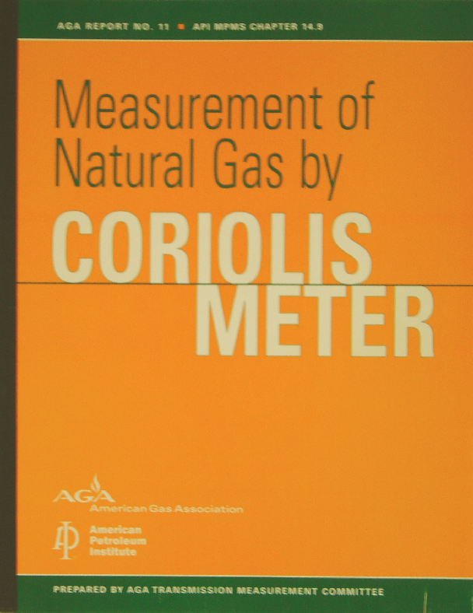
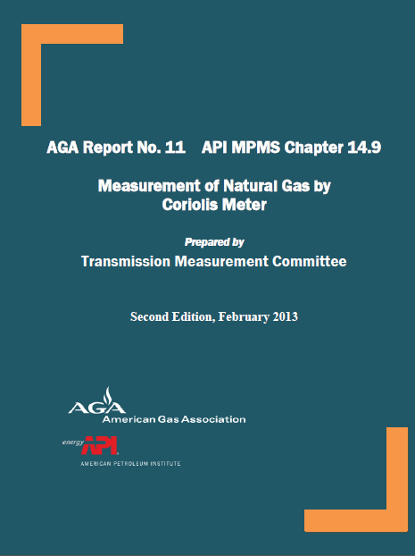
AGA Report No. 11 / API MPMS Ch. 14.9
Measurement of Natural Gas by Coriolis Meter
Published December 2003
(1st Edition)
Revised February 2013
(2nd Edition)
Notes:
This guideline has been around for over ten years. Coriolis is a well established and accepted method of metering natural gas. It is on par with AGA 3/7/9.
What changed in 2nd Edition?
Tightening of performance requirements from ± 1.0% to ± 0.7%
Water calibration transfers to gas only when the manufacturer has proof of testing by a 3rd party.
Additional meter “verification” steps will guide the user on the need to flow test
Flow testing can be performed in the field per new guidelines
New appendices added:
Coriolis Gas Flow Measurement System
Coriolis sizing equation
Coriolis Uncertainty section and Example Uncertainty Calculation

Slide 18
Agenda
 | Introduction and Principle of Operation
 | Industry Standards
 | Calibration
 | Maintenance Best Practices
 | Application Selection and Volume Conversion
 | Meter Sizing and Installation Considerations
 | Typical Applications

Slide 19
Coriolis Meter Principle of Operation
How Flow Calibration Factor (FCF), Zero, and ΔT Relates to Mass Flow
Y = mx + b
mass flow rate = FCF (ΔT) + zero
Mass Flow
(lb/m)
Zero has only small impact as % of rate
FCF (Slope) is the relationship between the ΔT signal and mass flow, determined with the initial calibration
The Zero accounts for offset observed at no-flow conditions
A change in FCF means the relationship between the flow signal (ΔT) and the actual mass flow rate has changed
Zero has larger impact as % of rate
FCF
Adjusted FCF
Original Zero
ΔT
(µsec)
Adjusted Zero

Slide 20
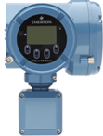
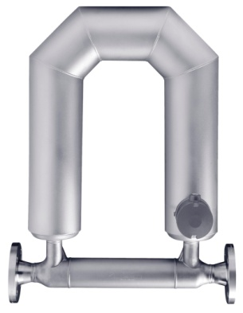
Conversion of Mass to Volume at Standard Conditions
AGA11 Eqn. D.2
lbs/day ÷ lbs/ft3 = ft3/day
AGA8 Detail
Non-ideal gas law:
P_{b}, T_{b}, R are constants
No Pressure or Temperature Measurement Required
to Convert from
Mass to Standard Volume
Note: Z_{b} does not vary more than 0.02% at base conditions.
AGA8 Gross 1 or 2
Base Density, Molar Weight, Base Compressibility, and Specific Gravity Are All Determined by Gas Composition
Notes:
Now, lets turn our attention directly to gas flow measurement.
The industry standard practices for trading in natural gas are based on units of standard volume and energy. On this slide, I will refer to standard volume as SCF as an abbreviation for Standard Cubic Feet. Standard volume is the volume of a fixed quantity of gas when it is at reference conditions. It is necessary to work in units of standard volume instead of actual volume because the actual volume of a fixed amount of gas will change dramatically as actual pressure and temperature are changing. To get to energy units, a gas chromatograph or other method is needed to measure the heating value of the natural gas. The heating value will vary with changing composition. The heating value can either be represented as energy units per unit of standard volume, such as BTU per standard cubic foot, or as energy units per unit of mass, such as BTU per pound mass.
The simplest and most accurate path to energy flow units is to multiply the mass flow by the heating value expressed in energy units per unit of mass and you are left with units of energy flow. However, if you have the need to work with heating values defined in units of energy per unit of standard volume, it is easy to make the conversion from mass to standard volume, as we are about to see, and then multiply by the heating value.
On this slide are shown three different equations for the conversion from mass to standard volume, or SCF. All three are essentially the same relationship. However, they each show this relationship in different terms that can be found within the AGA standards. The equation at the top shows the relationship in the simplest terms. Standard volume at reference conditions is just mass divided by base density, or the density of the gas at reference conditions. Note that base density is not the same as actual density, but rather it is a fixed constant that will not change unless the composition of the gas changes. Actual density will change, just as actual volume will change, when actual pressure and temperature are changing. In contrast, base density will not change due to changes in actual pressure and temperature.
[CLICK]
To see this relationship in some example units, divide mass flow rate in pounds per day by base density in lbs per cubic foot and you are left with cubic feet per day, units of standard volume flow rate.
[CLICK]
The second equation shows the relationship in terms of the non-ideal gas law as described in AGA 8. The third equation shows the relationship in terms of specific gravity. Many of the terms in the second and third equations are fixed constants will never change. These include the pressure and temperature at reference conditions, P sub b and T sub b, as well as the gas constant, R, and the density of air at reference conditions.
[CLICK]
Note that the molar weight, the compressibility at base conditions, and the specific gravity of the gas are all values that are determined entirely by the composition of the gas. They do not change as actual pressure and temperature change.
[CLICK]
In fact, even as changes in composition do occur, the compressibility at base conditions will only change very slightly, 0.02%, as a result.
[CLICK]
To recap, when the flow is measured directly by mass with a Coriolis meter it is still necessary to know the composition in order to convert to either energy or standard volume, but it is never necessary to know the actual pressure or temperature to convert units to base conditions because the mass of a fixed quantity or amount of gas will never change, even when the actual pressure and temperature are changing.
“There is no other measurement technology for which the energy and standard volume calculations are this simplistic!”

Slide 21
AGA 11 Sensor Mass Flow Calibration
Established on Water
Section 7 – Gas Flow Calibration Requirements
Manufacturers are responsible for initial flow calibration of Coriolis meters prior to delivery. Calibration with an alternative calibration fluid (e.g.. water) is valid with Coriolis sensor designs where the transferability of the alternative calibration fluid, with an added uncertainty relative to gas measurement, has been demonstrated by the manufacturer through tests conducted by an independent flow calibration laboratory. When the transferability of the manufacturer’s calibration fluid to gas cannot be verified, the meter shall be flow calibrated on gas as per the requirements in Section 7.1

Slide 22
Calibration Fluid Flexibility
“Calibration fluid flexibility” is a capability that allows a traceable liquid calibration to be used for traceable gas measurements
Meters may be calibrated for natural gas in liquid laboratories
  Liquid calibration recognized in AGA Report No. 11 (aka.: API MPMS Ch. 14.9)
  Must demonstrate acceptable provenance for each Coriolis meter design
  Advantages of liquid calibration:
    Meets manufacturers accuracy spec and AGA 11 direct from the meter factory
    Factory calibration (e.g., water) = Low cost
    Direct Shipment from meter factory to installation site = Fast project execution
    Better reference standard uncertainty possible with liquid labs
    Portable liquid flow calibration rig can be used for traceable onsite calibration at field locations
Meters may also be calibrated in gas laboratories
  Piece-Wise Linearization (PWL) Option is available for fine tuning by 3rd - party gas labs
    Potential to reduce Lost and Unaccounted For (LAUF) gas with improved measurement
    Similar to practice used by gas ultrasonic flow meters
  Meter calibration traceability chain tied directly through gas calibration standards

Slide 23
NMi Euroloop Testing of Meters to Prove Liquid Cal is Suitable for Gas Measurement
*Manufacturer Dependent (meter shown as example)

Slide 24
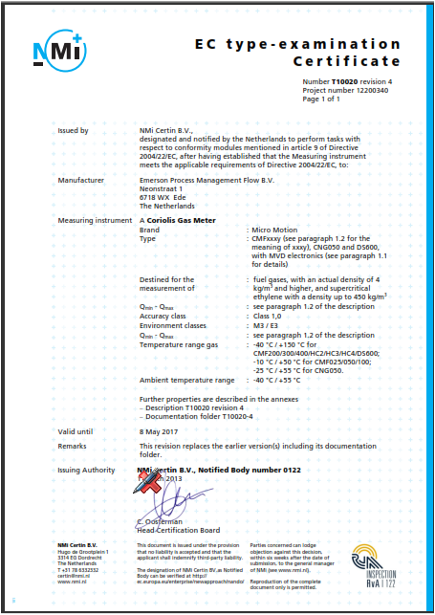
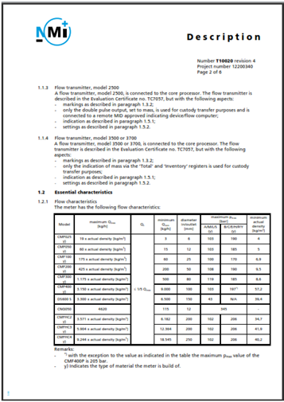
Sensor Calibration Established on Water
3rd Party Testing and Certification

Slide 25
Calibration Adjustment Methods
Described in AGA 11
Flow Weighted Mean Error (FWME)
Polynomial Algorithm
Multi-Point Piecewise Linear
Interpolation (PWL)
Piecewise Linearization
(Step-wise)

Slide 26
Multi-Point Piecewise Linear Interpolation (PWL)
Correction applied at selected linearization points is equal and opposite to the average of the as-found values at the same flow rate
Correction values applied between neighboring points are determined by linear interpolation between the two points
Correction above the highest flow rate point are held constant
Correction below the lowest point is based on linear interpolation to zero error at zero flow to allow meter zero adjustment to control accuracy below Q_{t}

Slide 27
Results with PWL – 1-inch Meter CMF100
Observations
Test turndown ≈ 58 : 1
All verification averages
better than ± 0.08%
Verification averages above
0.13 lbm/sec
better than ± 0.027%
All verification data
better than ± 0.11%
All Data
Averages at Each Flow Rate
Notes:
Some Coriolis meters have the demonstrated capability to be calibrated on liquid in order to measure gas
Some Coriolis meters can be adjusted with PWL in gas calibration labs to improve gas flow measurement

Slide 28
Agenda
 | Introduction and Principle of Operation
 | Industry Standards
 | Calibration
 | Maintenance Best Practices
 | Application Selection and Volume Conversion
 | Meter Sizing and Installation Considerations
 | Typical Applications

Slide 29
Section 9 – Meter Verification / Flow Performance Testing
The meter manufacturer should provide the meter operator with written field meter verification test procedures that will allow the Coriolis meter, as a component of the measuring system, to be verified as operating properly and performing within the measurement uncertainty limits required by the designer/operator
The field verification should identify possible change in the system’s performance and the cause
The evaluation of these indicators will guide the operator in determining the need to re-zero the Coriolis meter or execute a flow performance test (in-situ or laboratory), etc.

Slide 30

Prior AGA 11 Coriolis Verification Practice
  Meter Zero Verification
    Corrosion, erosion, mounting stress, flow tube damage, and coating
    Catch-all diagnostic
    Works well, but very broad indicator
  Meter Diagnostics Check
    Diagnostics
      Electronics
      Processing and memory
      Measurement system health
        Within normal limits
        Catastrophic failure
Pass/Fail
Not quantitative

Slide 31

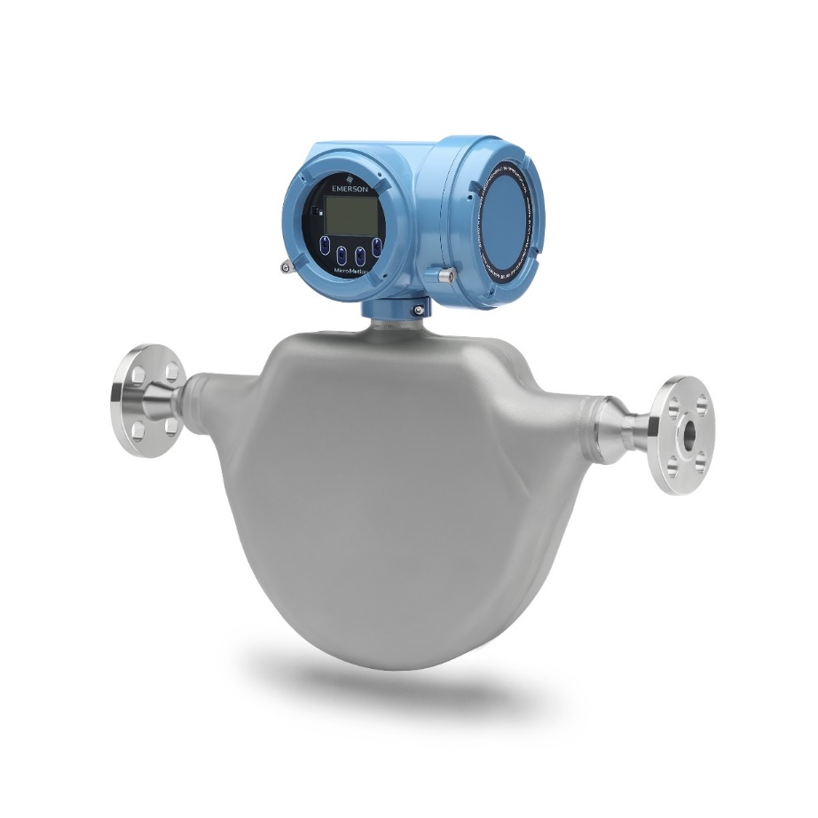
Perform In-Situ Verifications Quickly and Easily to Increase Confidence and Reduce Downtime
SMV is Easy to Use
On-demand One button/command No extra equipment Formal report Less than 2 minutes No interruption to process or measurement Scales with host systems Evaluate meter under “as installed” conditions
Notes:
Smart Meter Verification helps end-users confirm their meter is performing within specifications with minimal costs and effort.
Smart Meter Verification can be performed in-situ, without interrupting the measurement, in less than two minutes – while creating a formal report, recognized by many agencies, that can even extend recalibration or proving times.
Now that we understand why a customer needs to verify their Coriolis meter - let’s discuss how Smart Meter Verification works.

Slide 32
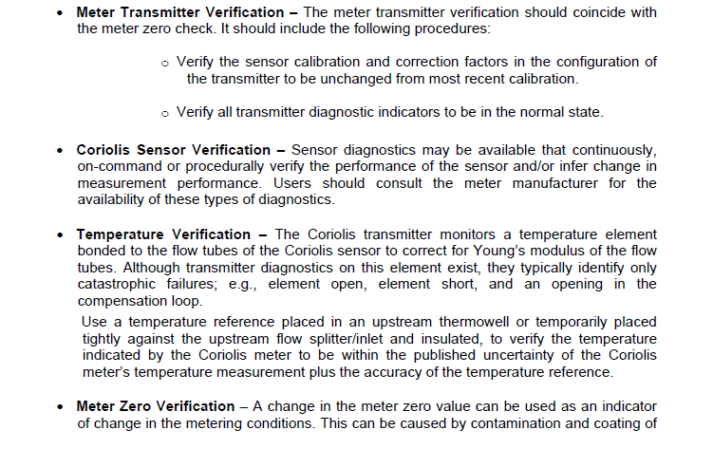
New AGA 11 Coriolis Verification Practice

Slide 33
AGA11 Section 9
– Meter Verification Cont.
Meter Verification @ a minimum entails…
  Meter Transmitter Verification
    Diagnostics
  Coriolis Sensor Verification
    Diagnostics
      Flow Tube Structure Diagnostic (FCF)
  Temperature Verification
    Check it…. Don’t calibrate it unless out of tolerance
  Meter Zero Verification
    Check it…. Don’t calibrate it unless out of tolerance
      Zero Verification Tool
Compare to upstream temperature reference.
Per AGA, check within 4 weeks of installation and quarterly during first year.

Slide 34
AGA11 Section 9.2
– Periodic Flow Performance Testing
Should flow performance testing be required several options exist…
Remove from service and send to the manufacturer or third party lab.
In-situ flow test as outlined in this section or in accordance with AGA6, Field Proving of Gas Meters Using Transfer Methods
New - Remove from service for flow test with a portable weigh scale system or certified meter using an alternate fluid. Must have certification of transferability (3rd party)
When a Meter Under Test (MUT) is tested against a field reference, the MUT should not be adjusted if the performance is found to be within the uncertainty of the field reference

Slide 35
Agenda
 | Introduction and Principle of Operation
 | Industry Standards
 | Calibration
 | Maintenance Best Practices
 | Application Selection and Volume Conversion
 | Meter Sizing and Installation Considerations
 | Typical Applications

Slide 36
Unique Attributes of Coriolis Technology
Resolves common measurement problems
Water calibration transfers to gas
  Reduced meter flow calibration and verification costs
  Out-of-box + 0.25 - 0.35% accuracy on gas
  Turbine, ultrasonic, and rotary require gas calibrations
No flow conditioning or piping requirements
  Elimination of errors due to flow profile disturbances and the cost of monitoring for their occurrence
  Major concern in use of Ultrasonic, Turbine, Orifice
No errors caused by pulsations and noise radiated from flow regulation
  Flow pulsations cause error in every flow technology except Coriolis
  Turbine and Rotary also incur mechanical damage when subjected to pulsating flows
No over-registration or damage due to flow surges
  High rate-of-change during fuel gas start-up… “flow surge”
Reynolds Number
Asymmetrical Profile
Swirl
Pulsating Flow

Slide 37
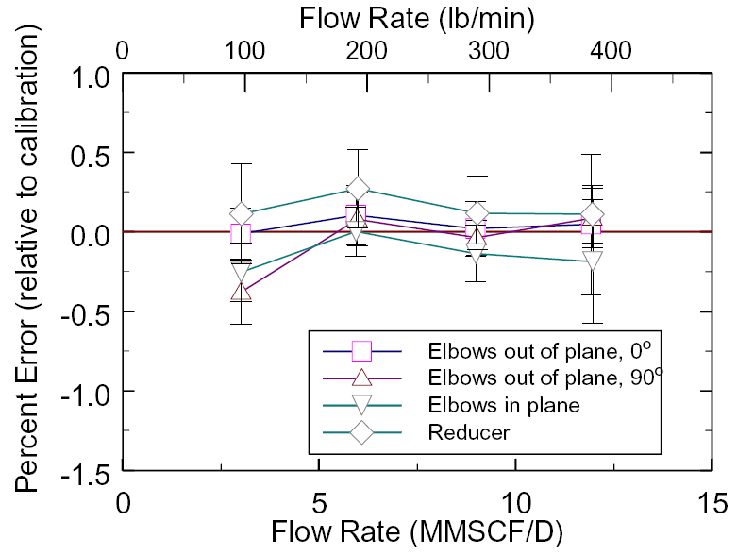
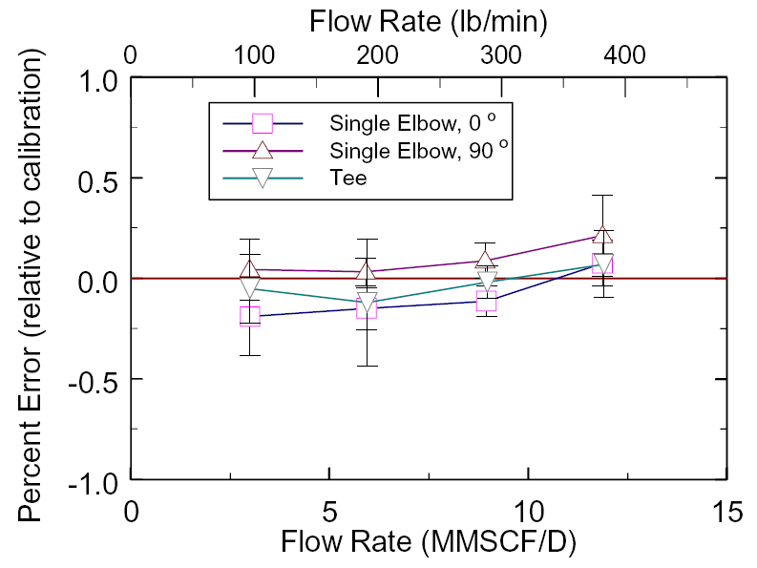
AGA 11 – Gas Operating Conditions
“Upstream Piping and Flow Profiles”
No Flow Conditioning or Special Piping Required
Performance with Lab Uncertainty

Slide 38
GERG Installation Requirements
“No Error Effects from Regulator Location”
Notes:
Coriolis meters are immune error caused by regulator noise.
In the graph shown, you see testing performed by Gasunie in the Netherlands for GERG (European Gas Research Group)
The testing shows test data, with the blue line designating the test where a Micro Motion Coriolis meter was tested with 100 diameter of straight pipe in front of the Coriolis meter.
The red line shows test data, where a regulator was placed upstream (the worst possible regulator disturbance possible) of the Coriolis meter.
What the data shows is there is no regulator influence on the Coriolis meter and regardless of regulator location it will have no affect on the Coriolis meter’s measurement.

Slide 39
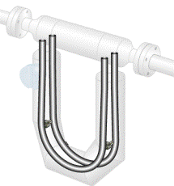
Micro Motion- Pulsation Immunity
GERG - No Gas Pulsation Error Concerns
Ideal Meter for…
  Gas leg of separators
  Fuel gas measurement to reciprocating engines
  Measurement at or near inlet and outlet of reciprocating compression
  Measurement near regulation; i.e. flow through regulator pulsates at low flows
1200 RPM
Pulsation Frequencies (Regulator, Compressor, etc.) in Gas Applications are less than 20 Hz
Flow Tube Resonant Frequency 80 Hz
80
Manufacturer dependent

Slide 40
Micro Motion Vibration Immunity
Flow Tube Resonant Frequency 80 Hz
80
Vibration Frequency of a Reciprocating Compressor less than 2400 RPM or 40 Hz

Slide 41
AGA11 – Gas Velocity and Filtration
Coriolis flow tubes typically do not erode from high gas velocities (example Orifice Plate)
Gas velocities & pressure drop similar to other measurement technologies (Orifice, Turbine)
Meter should be protected from abrasive particles
Flow tube coating/debris build-up appears as zero offset (zero offset affects low-end not high-end performance)

Slide 42
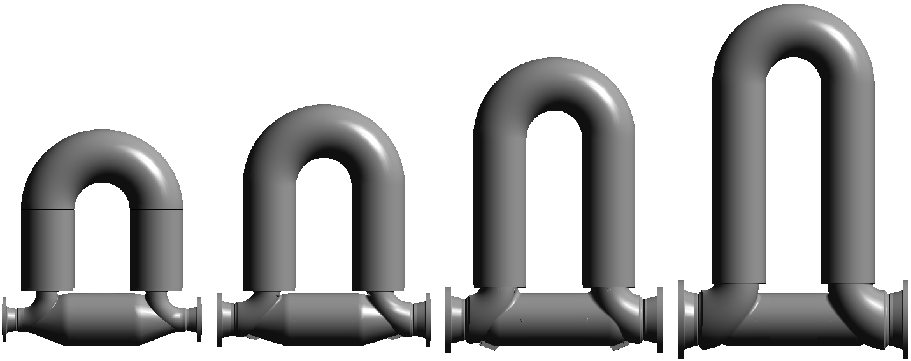
Large Diameter Coriolis and Pressure Drop
Coriolis | CMF400 | CMFHC2 | CMFHC3 | CMFHC4
Typical Line Size | 4 - 8” (100-150mm) | 6 -10” (150-200mm) | 8 -12” (200-250mm) | 10 -16” (250-300mm)
Flow @ 6 psid Flow @ 15 psid | 69 MMSCFD 187 MMSCFD | 129 MMSCFD 318 MMSCFD | 223 MMSCFD 485 MMSCFD | 341 MMSCFD 743 MMSCFD
69 MMSCFD
129 MMSCFD
223 MMSCFD
341 MMSCFD
Ultrasonic Meter Comparison (Max Flow = 100 ft/sec & 6 psi pressure drop, CPA50E )
Max Flow | 4” = 47 MMSCFD 8” = 189 MMSCFD | 6” = 106 MMSCFD 10” = 295 MMSCFD | 8” = 189 MMSCFD 12” = 425 MMSCFD | 10” = 295 MMSCFD 16” = 756 MMSCFD
4” = 47 MMSCFD
6” = 106 MMSCFD
8” = 189 MMSCFD
10” = 295 MMSCFD
Notes:
Canada Pipeline Accessories 50E most common – lots of data and lowest pressure drop
100 ft/sec is max velocity of a USM

Slide 43
Effect of Pressure on Coriolis Meters
Internal pressure changes the shape of the flow tube
  Tube ovality becomes round
  Tube bends straighten
Changes in flow tube shape increases stiffness of flow tube
Changes in flow tube stiffness can affect sensor calibration
Magnitude of effect varies by meter size and design

Slide 44
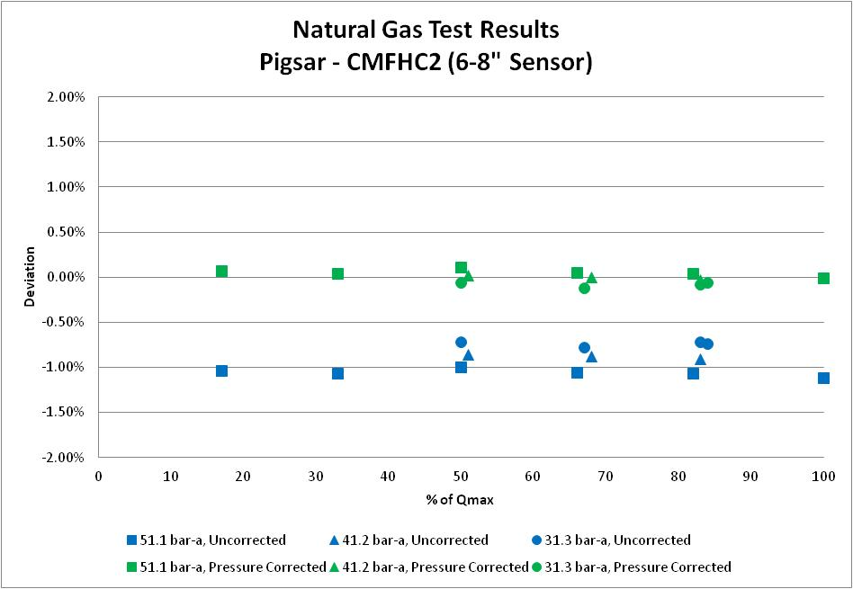
Example of Pressure Effect Compensation
Large Meter Gas Test Results
All data collected on natural gas using meter factory calibration on water
Data shown with and without standard F_{P} pressure compensation
Max deviation of all compensated data < 0.25%

Slide 45
Agenda
 | Introduction and Principle of Operation
 | Industry Standards
 | Calibration
 | Maintenance Best Practices
 | Application Selection and Volume Conversion
 | Meter Sizing and Installation Considerations
 | Typical Applications

Slide 46
Gas Sizing Best Practices - Coriolis Meter Turndown
High Pressure = High Turndown
Ideal meter location is upstream of regulator

Slide 47
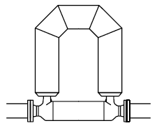

Installation Best Practices
Orientation & Piping Requirements
Gas
No special upstream or downstream piping requirements
Vertical line installations
  Flow tubes in flag position
  Flow direction down preferred
  for gas (especially for WET GAS!!!)
  Flow direction up preferred for liquid
Horizontal line installations
  Flow tubes up preferred for gas
  Flow tubes down preferred for liquid
Liquid
Gas
Liquid

Slide 48
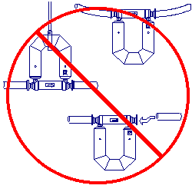
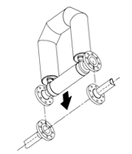
AGA11 - Installation Best Practices
Piping Alignment and Support
Proper weight support
  No sagging pipes
  Piping supports installed near upstream and downstream flanges of meter
Meter flow tube case is sacred ground
  Case should not be used to support the meter or other equipment
Proper alignment of piping & flanges
  Use of fabrication spool piece when fabricating piping in the field (slip-fit desired)

Slide 49
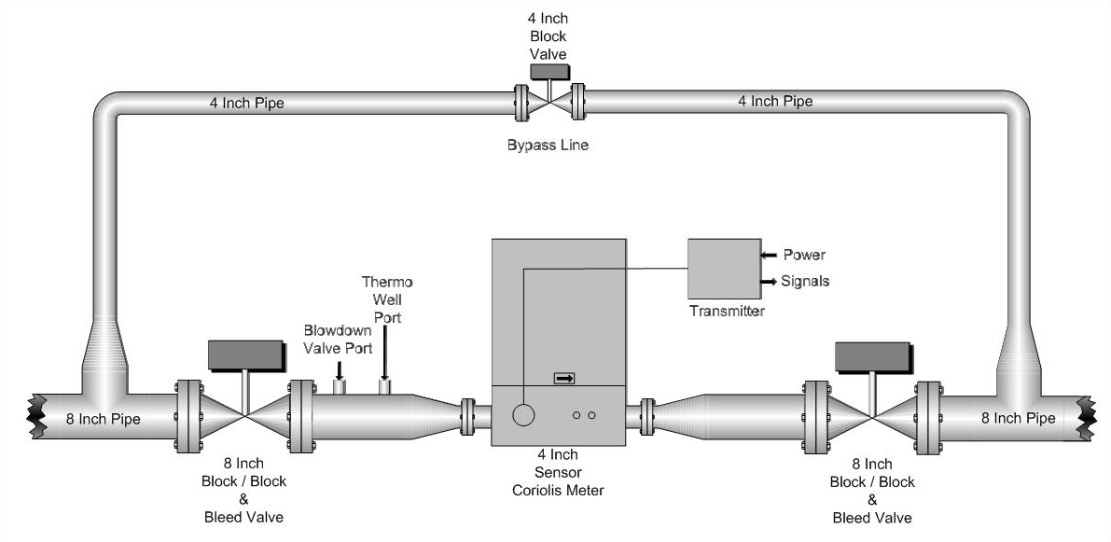
AGA11 - Installation Best Practices
Piping Operational Requirements
Upstream and Downstream Block Valves
Bypass to Eliminate Interruption of Service
Pressure Port Upstream of Sensor
Temperature Port Upstream of Sensor
  Avoid Joules Thomson Effect issues downstream

Slide 50
Agenda
 | Introduction and Principle of Operation
 | Industry Standards
 | Calibration
 | Maintenance Best Practices
 | Application Selection and Volume Conversion
 | Meter Sizing and Installation Considerations
 | Typical Applications

Slide 51
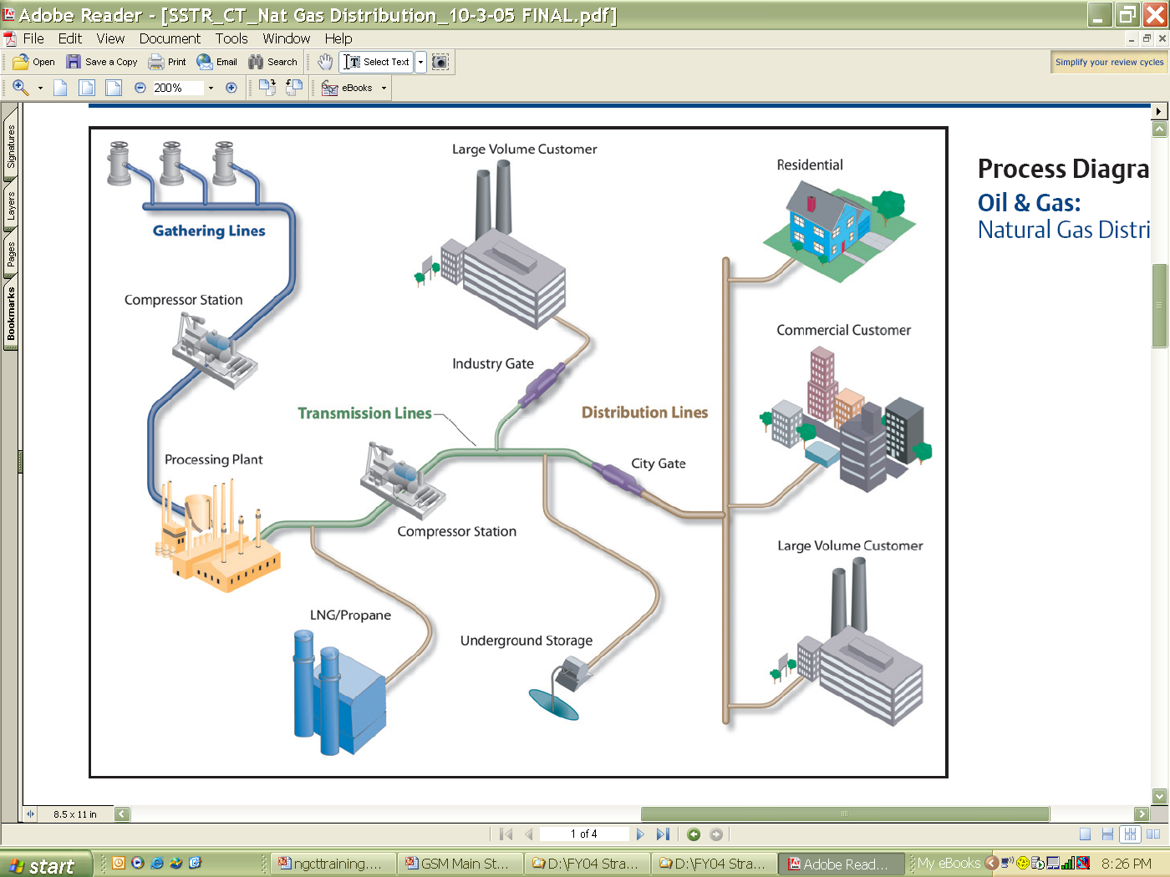
Natural Gas Industry
Coriolis Sweet Spots
Custody Transfer
  Natural gas city, commercial, and industry gates
    Pay and check meters
  Gathering stations
  Specialty gas
    Pure and unusual gas mixtures
Fiscal
  Fuel gas
  Gas storage
Operations
  Efficiency control
  Injection meters
Notes:
Market opportunities for the 3711 in the are at upstream “gathering”, fuel gas to compression, industry gates, storage, city gates, and measurement

Slide 52

The “Coriolis” Effect….
Safety Improvement
  Reduction in human intervention into equipment, the process, and hazardous situations
Accurate and Efficient Asset Management
  Reduction in measurement and control uncertainty
  Operating cost reduction
Sustainability of Operations
  Improvement in system performance and reliability

Slide 53
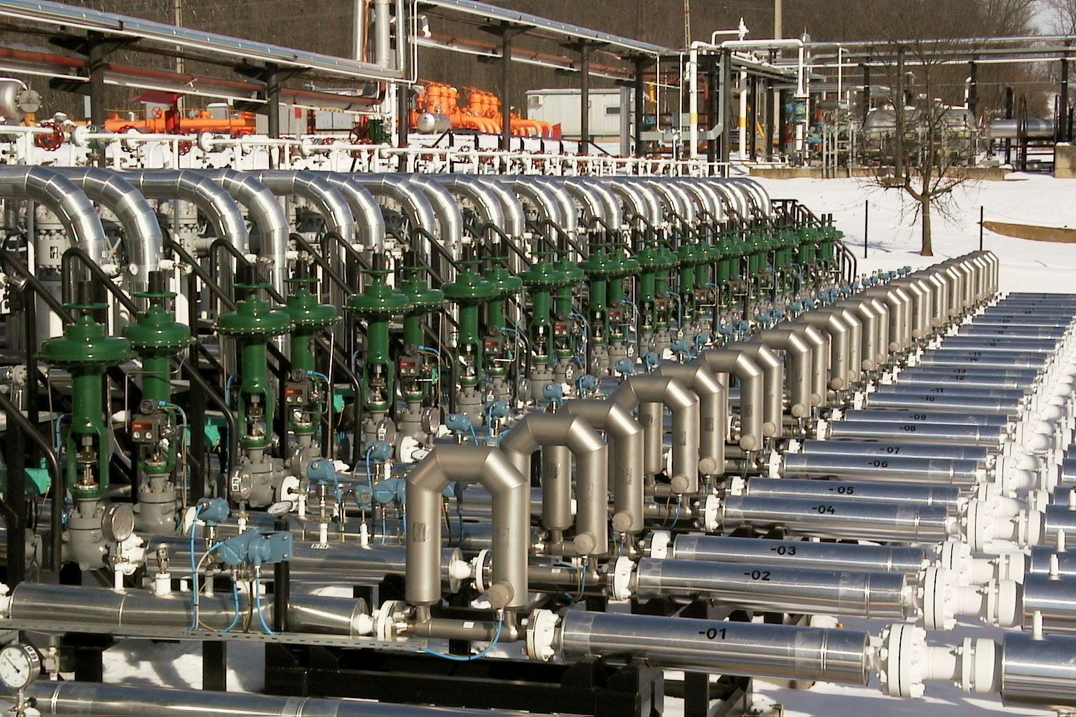
Thank You!

